Slide 1




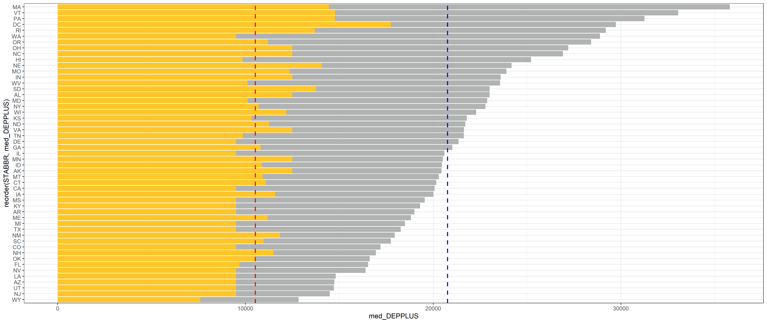
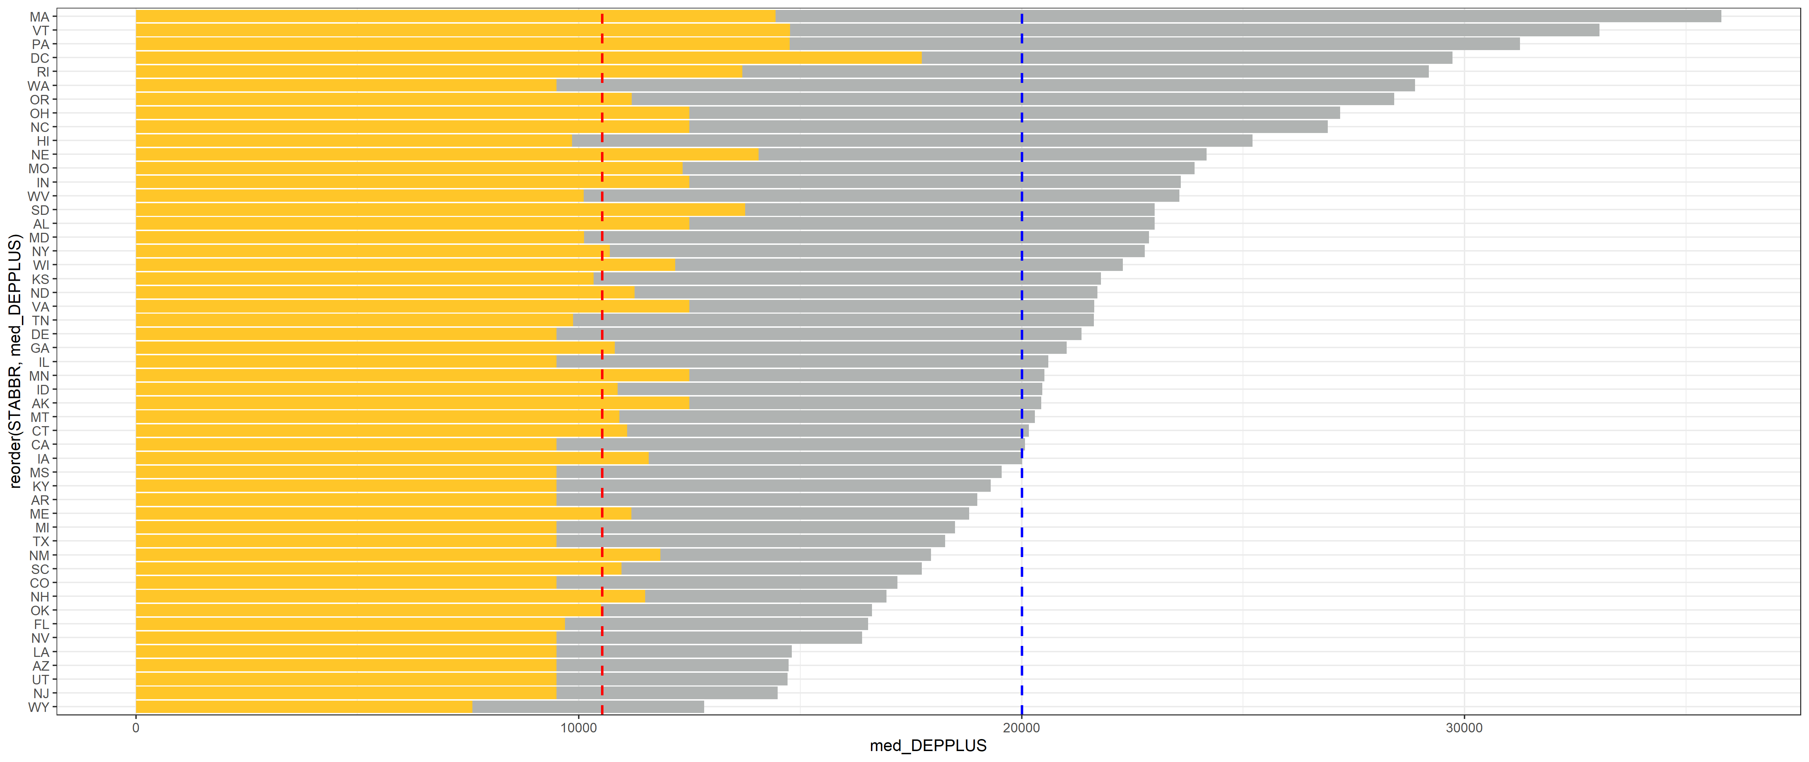
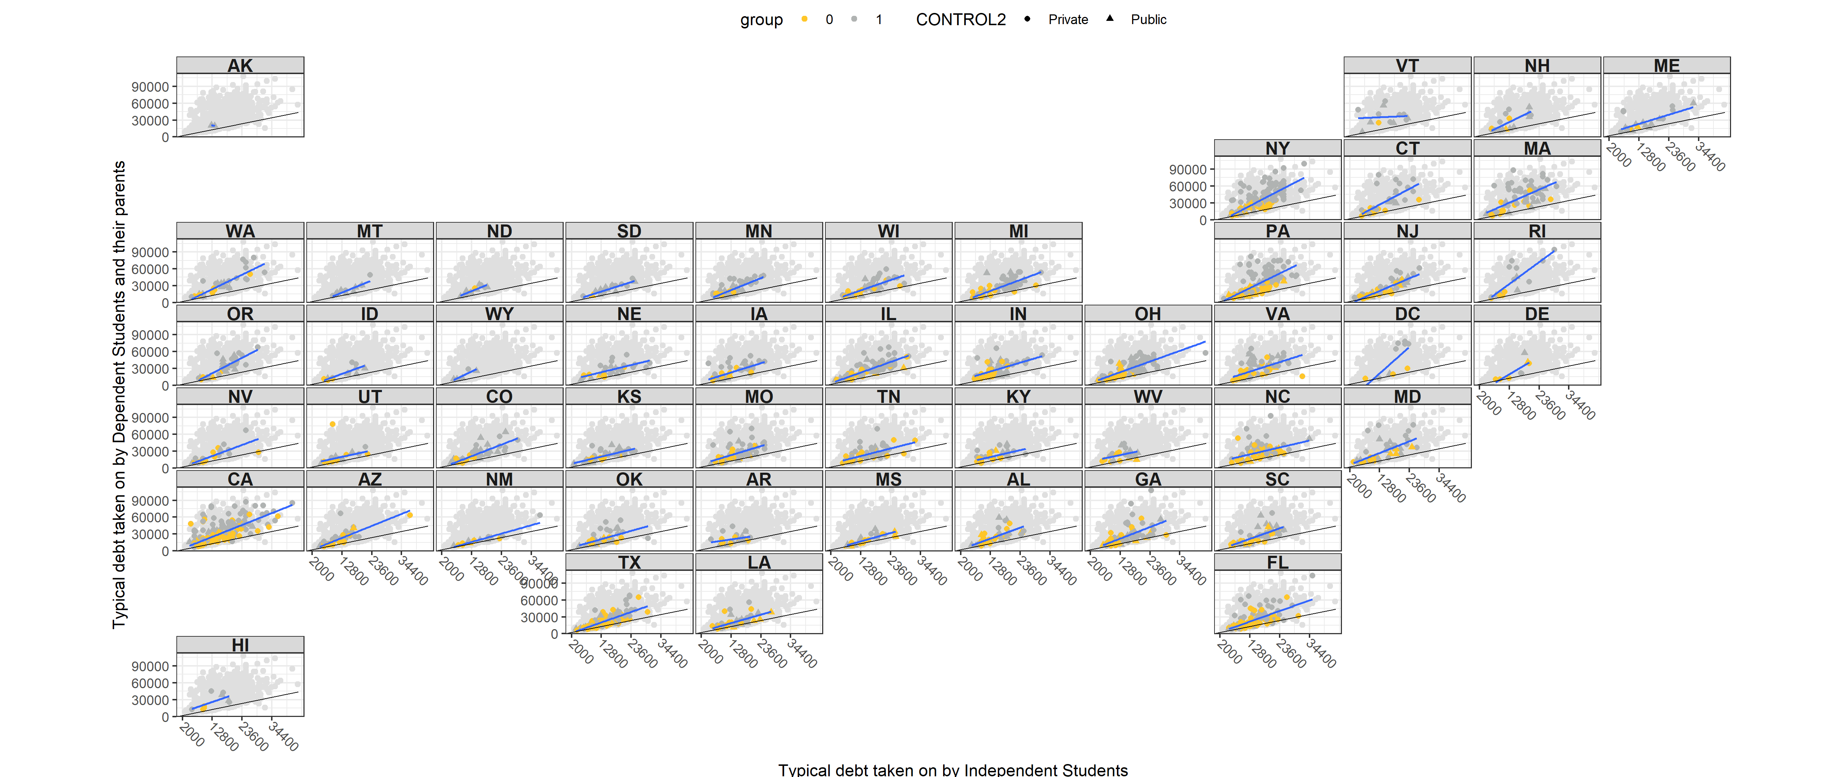
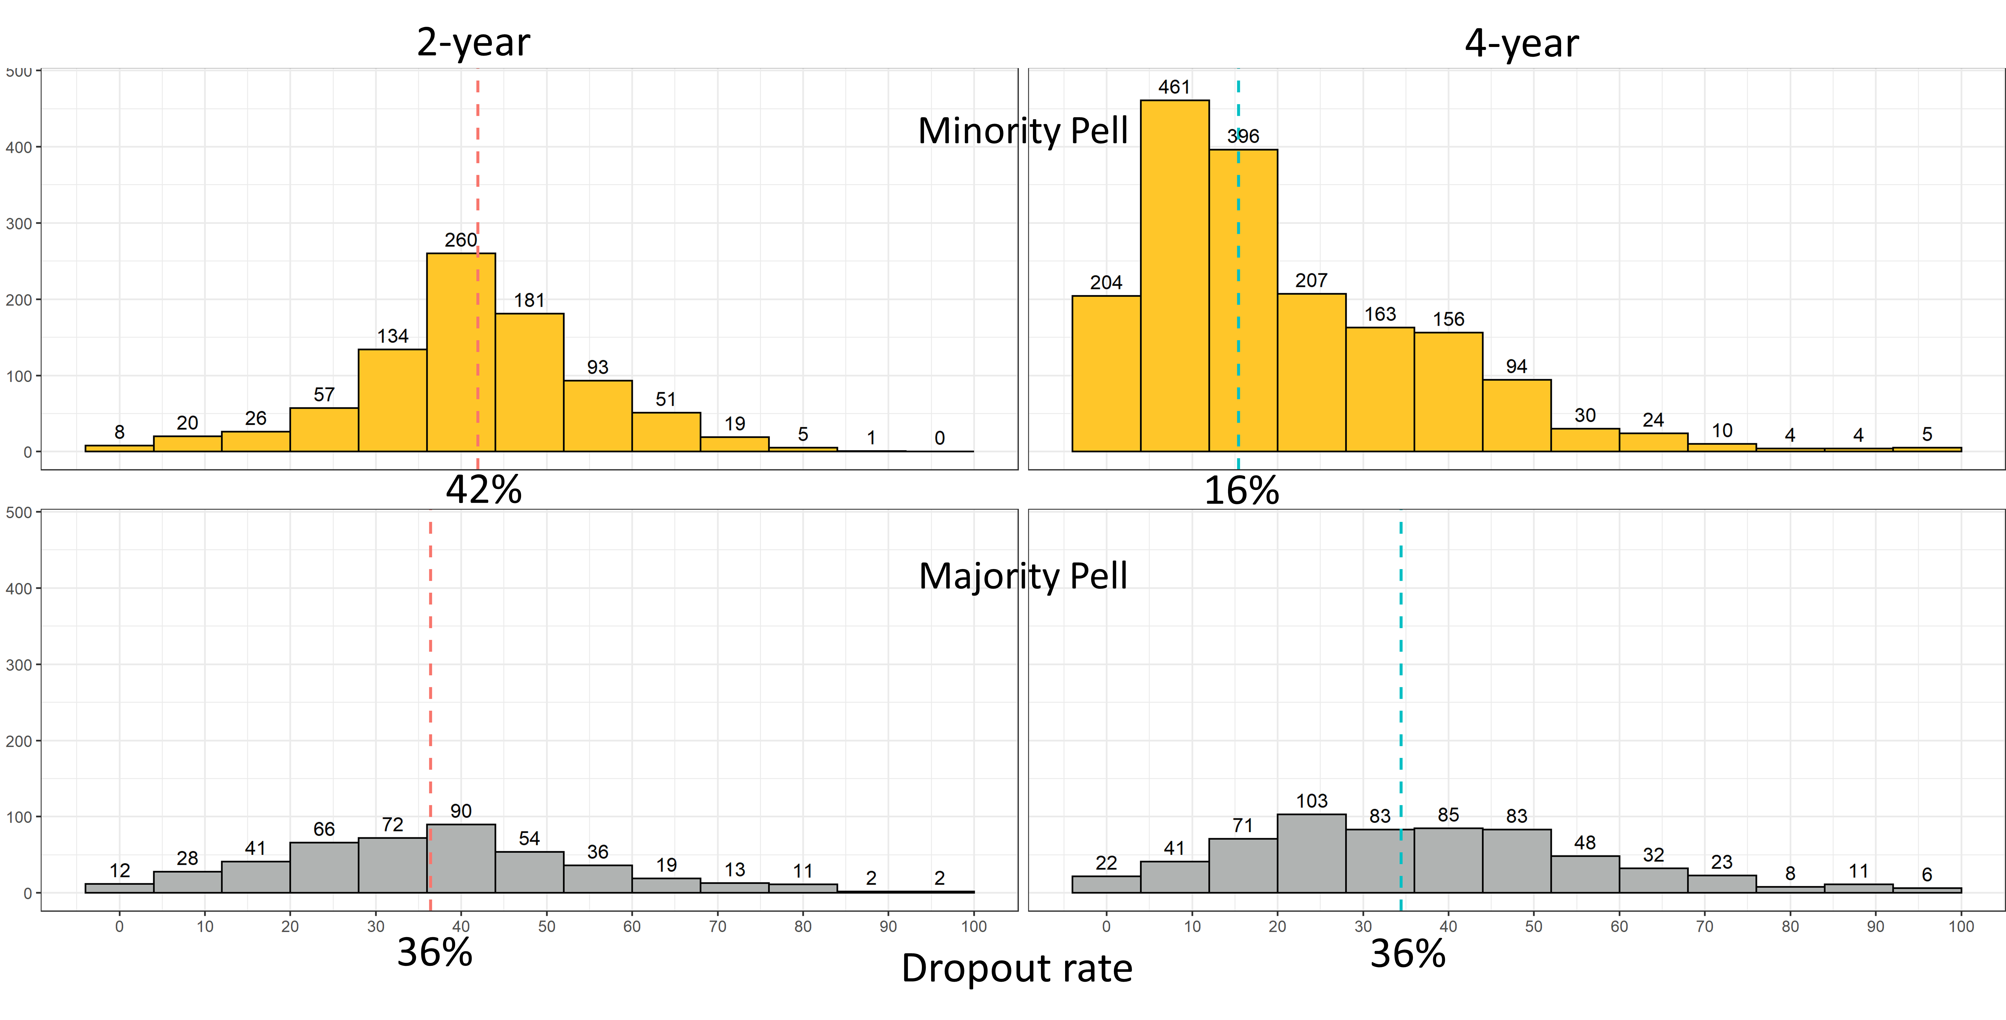
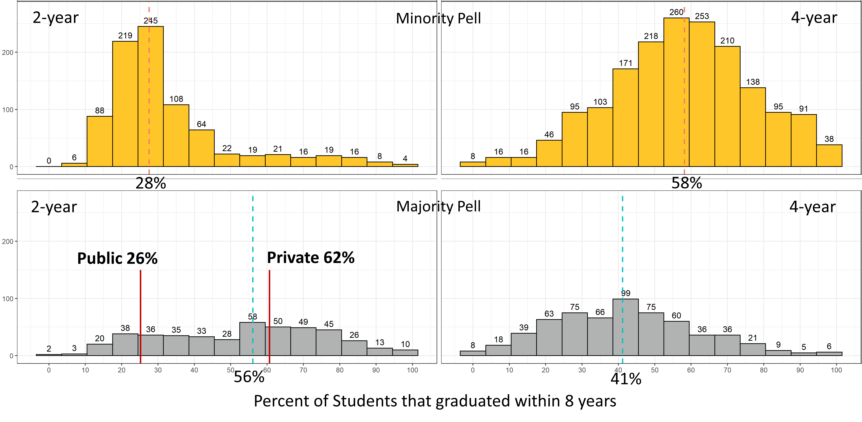
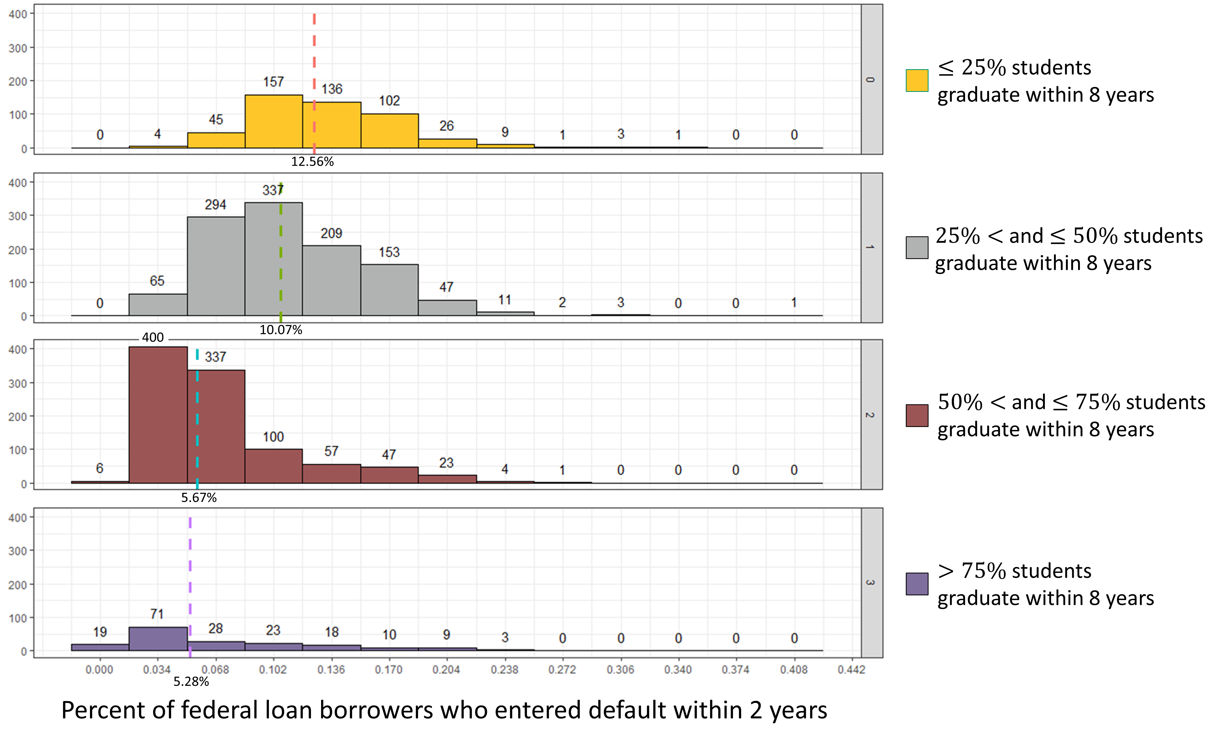
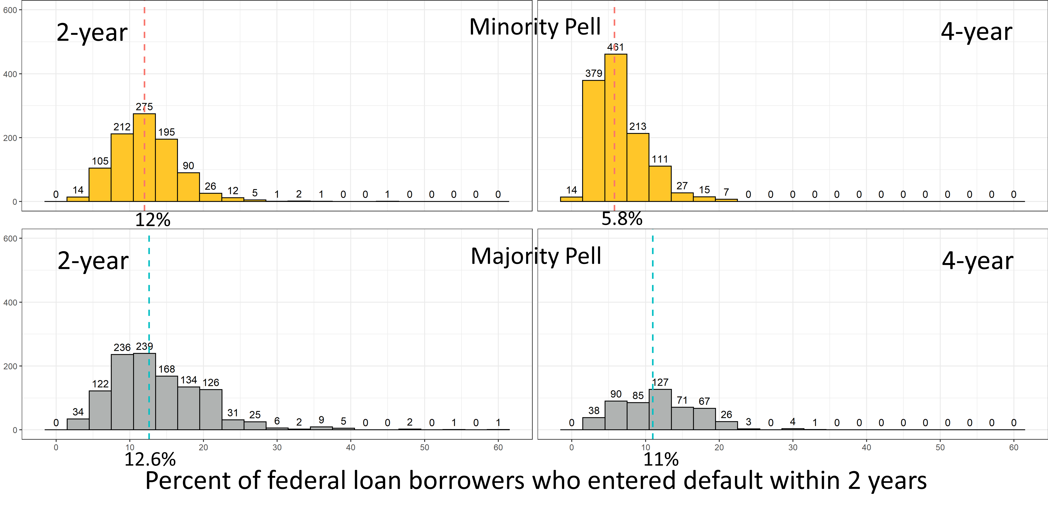


The CollegeScorecard dataset consist of 2,381 features, 3 id variables, and 6654 rows.
.7% of students
DOES THE PELL GRANT COME WITH A PRICE?
Nathaniel Jones
Faculty Advisor: Professor Susan Mathews Hardy and Professor J. Hathaway
Independent and Dependent Student Debt Vertical Stratified Bar Chart (Figure 1): The length of the gold bar represents the median independent student debt for each state. The length of the grey bar represents the median dependent student debt with their parents for each state. The length of the gold bar is superimposed over the grey bar and both bar lengths start from zero. Dependent students with their parents accumulate more debt than independent students across all states. For all institutions in the dataset, the vertical red line corresponds to the median debt for independent students as they exit the institution they attended. The blue line corresponds to the median debt for dependent students and their parents as they exit the institutions.
Independent and Dependent Student Debt U.S. Map (Figure 2): The relationship between the typical amount of debt a dependent student receives with their parents (Y) and the typical amount of debt an independent student receives (X) is displayed for each state in blue. In comparison, the black line is the relationship for the whole dataset including all states if the two debt amounts were equal. The black line and the grey background of all datapoints in the set standardize the size of the graph for all states.
Student Dropout Rate Stratified by combinations of Control and Majority/Minority Pell Status (Figure 3): The dropout rate for 4-year minority Pell institutions is much lower (16%) than other combinations (42%, 36%, 36%). Notably, 2-year minority Pell institutions have the highest dropout rate of all (42%). One source suggested that students at 2-year institutions do not realize that they can use the Pell grant for a 2-year institution. Possibly, by informing their students about the Pell grant opportunity, some of the minority Pell institutions may be able to switch to the majority Pell classification and lower their dropout rate.
Student Graduation Rate Stratified by combinations of Control and Majority/Minority Pell Status (Figure 4): The overall 2-year minority Pell graduation rate (28%) is half the overall 2-year majority Pell graduation rate (56%). Again, informing 2-year minority Pell institution students about the Pell grant opportunity may improve graduation rates.
Breakdown of Pell, Years, and Control Waffle Charts (Figure 5): The number of minority Pell institutions exceeds the number of majority Pell institutions. Within the majority Pell institutions, the number of private institutions greatly exceeds the number of public institutions for both 2-year and 4-year schools. The fact that private institutions greatly exceed public in the majority Pell category suggests that private institutions are better at conveying the availability of the Pell grant to their students.
Default Rate Stratified by Graduation Rate (Figure 6): The default rates for institutions with graduation rates of 50% or less are 12.56% and 10.07% In contrast, the default rates for institutions with graduation rates greater than 50% are 5.67% and 5.28%. Increasing the graduation rates may help students pay off their loans. For institutions with a graduation rate greater than 50% the median 2-year default rate is 5.67% while for institutions with a graduation rate of 50% or less the median 2-year default rate is 11.09%. I am 95% confident that the true difference in the center of the two distributions is between 4.81% and 5.42%.
Student Default Rate Stratified by combinations of Control and Majority/Minority Pell Status (Figure 7): For 2-year institutions, the default rates are similar. However, for 4-year institutions, the loan default rate for majority Pell institutions is much higher (11%). This 11% agrees with the fact that in Figure 4, the 4-year majority Pell institutions had a graduation rate of 41%, which puts them in the category in Figure 6 that is associated with a loan default rate of 10.07%. The focus is again on increasing graduation rate to improve loan repayment.
INTRODUCTION
METHODS
CONCLUSIONS
The goal of this research is to use the CollegeScorecard dataset to determine which post-secondary schools and states are helping low-income students succeed. This success is measured by the institution’s student graduation rate, loan default rate two years after graduation, dropout rate, and the typical amount of debt acquired by an independent student or a dependent student with their parent as they exit the institution, either by graduating or dropping out. The proportion of students still trying to finish their degree 8 years after their first enrollment is 0.4%, I am one of those 0.4%. I had to learn the implications of the dependency status the hard way. I had to find a way to attend school, even when I was homeless, had medical issues, and could not afford food. I had to learn financial and life lessons that are usually taught by the family.
I propose that an educational institution provide mandatory training on the implications of dependent and independent status, as to whether the student will receive any of the parental loans that are taken out in their behalf. In addition, 4-year institutions, which have the majority of their student populations receiving a Pell grant, have lower graduation rates and higher dropout rates, resulting in higher loan default rates 2 years after the student leaves the institution. Educational institutions need to take their stewardship of Pell grant recipients seriously by providing coaching that will help them with academic success—skills that a high-income family generally provide for their children. By meeting the needs of Pell grant recipients, they will better meet the needs of all students at their institutions.
Coding Methods: I used tidyverse to pipe functions (e.g. mutate, filter, select, and lapply). I used packages that include stringr, pplyr, dplyr, magrittr, ggplot, ggpubr, ggh4x, geofacet, sf, sp, and tidycensus. My favorite package is magrittr because of the assignment pipe %<>%.
Data Wrangling: For the CollegeScorecard dataset, I created an anonymous function that checks each column for missing values, and then I dropped all columns with zero entries. Observations that were missing their institutions name, proportion of Pell recipients in their student population, their longitude and latitude, and their state were dropped. This left a total of 952 variables and 6186 observations. As I did my analyses, I created multi-layer filters to create the needed subsets.
Spatial Analysis: The census shapefiles and data from the packages tigris and tidycensus were used to create maps of the institutional locations by state. I joined together the polygons of the states that are provided in the shapefile with the latitude and longitude of each school from the CollegeScorecard data.
Nonparametric Binomial Distribution Test and Confidence Intervals: The binomial test was used to verify the National Center for Education Statistics’ claim that the average net price at a 4-year institution is $18,500.
K-sample Permutation Tests: The K-sample Permutation Test was used to analyze whether graduation rate quartiles predicted the loan default rate.
Permutation Tests on the Median: For majority and minority Pell schools, I tested to see if there was a difference between the median dropout rate, graduation rate, and the 2-year loan default rate.
Permutation test on the slope: The permutation test on the slope was used to determine if there was a relationship between independent and dependent student debt.
Geom_smooth: This function in ggplot was used to map the slope of independent student debt by dependent student debt over the state of the institution.
Graphics: Stratified waffle charts, stratified histograms, a stratified vertical bar chart, and a geofaceted map were used to visualize the findings.
Independent and Dependent Student Debt Vertical Stratified Bar Chart (Figure 1): The length of the gold bar represents the median independent student debt for each state. The length of the grey bar represents the median dependent student debt with their parents for each state. The length of the gold bar is superimposed over the grey bar and both bar lengths start from zero. Dependent students with their parents accumulate more debt than independent students across all states. For all institutions in the dataset, the vertical red line corresponds to the median debt for independent students as they exit the institution they attended. The blue line corresponds to the median debt for dependent students and their parents as they exit the institutions.
Independent and Dependent Student Debt U.S. Map (Figure 2): The relationship between the typical amount of debt a dependent student receives with their parents (Y) and the typical amount of debt an independent student receives (X) is displayed for each state in blue. In comparison, the black line is the relationship for the whole dataset including all states if the two debt amounts were equal. The black line and the grey background of all datapoints in the set standardize the size of the graph for all states.
Student Dropout Rate Stratified by combinations of Control and Majority/Minority Pell Status (Figure 3): The dropout rate for 4-year minority Pell institutions is much lower (16%) than other combinations (42%, 36%, 36%). Notably, 2-year minority Pell institutions have the highest dropout rate of all (42%). One source suggested that students at 2-year institutions do not realize that they can use the Pell grant for a 2-year institution. Possibly, by informing their students about the Pell grant opportunity, some of the minority Pell institutions may be able to switch to the majority Pell classification and lower their dropout rate.
Student Graduation Rate Stratified by combinations of Control and Majority/Minority Pell Status (Figure 4): The overall 2-year minority Pell graduation rate (28%) is half the overall 2-year majority Pell graduation rate (56%). Again, informing 2-year minority Pell institution students about the Pell grant opportunity may improve graduation rates.
Breakdown of Pell, Years, and Control Waffle Charts (Figure 5): The number of minority Pell institutions exceeds the number of majority Pell institutions. Within the majority Pell institutions, the number of private institutions greatly exceeds the number of public institutions for both 2-year and 4-year schools. The fact that private institutions greatly exceed public in the majority Pell category suggests that private institutions are better at conveying the availability of the Pell grant to their students.
Default Rate Stratified by Graduation Rate (Figure 6): The default rates for institutions with graduation rates of 50% or less are 12.56% and 10.07% In contrast, the default rates for institutions with graduation rates greater than 50% are 5.67% and 5.28%. Increasing the graduation rates may help students pay off their loans. For institutions with a graduation rate greater than 50% the median 2-year default rate is 5.67% while for institutions with a graduation rate of 50% or less the median 2-year default rate is 11.09%. I am 95% confident that the true difference in the center of the two distributions is between 4.81% and 5.42%.
Student Default Rate Stratified by combinations of Control and Majority/Minority Pell Status (Figure 7): For 2-year institutions, the default rates are similar. However, for 4-year institutions, the loan default rate for majority Pell institutions is much higher (11%). This 11% agrees with the fact that in Figure 4, the 4-year majority Pell institutions had a graduation rate of 41%, which puts them in the category in Figure 6 that is associated with a loan default rate of 10.07%. The focus is again on increasing graduation rate to improve loan repayment.
Differences in the proportion of federal loan borrowers at majority vs minority Pell schools were tested. Confidence intervals on the difference in medians of the graduation rate, dropout rate, and loan default rate for majority and minority Pell schools were calculated.
The CollegeScorecard dataset includes measurements of the following parameters for 6,654 post-secondary institutions:
INSTNM: The name of the school.
STABBR: The state abbreviation.
LATITUDE & LONGITUDE: The latitude and longitude of the school.
PCTPELL: The percent of the student's population that receive a Pell grant.
ICLEVEL: The institutional class level (either 2-year or 4-year institution).
CONTROL: Whether the control of the institution is public or private.
OMENRUP_ALL: The 8-year outcome status measured as the proportion of students that did not receive an award (either a training certificate, associate, bachelor, or graduate degree) within 8 years of entry and their status is unknown.
OMAWDP8_ALL: The 8-year outcome status measured as the proportion of students that did receive an award (either a training certificate, associate, bachelor, or graduate degree) within 8 years of entry.
BBRR2_FED_UG_DFLT: The Borrower-based Repayment Rate measured as the percentage of undergraduate federal student loan borrowers in default after 2 years. Loans need to be paid back as compared to a Pell grant, which does not. These loans are either government-subsidized (interest starts accruing after graduation) or unsubsidized (interest starts accruing at the time the loan is taken) loans.
IND_DEBT_MDN: The median amount of direct loans (government-subsidized and unsubsidized) an independent student receives while attending that university.
DEP_DEBT_MDN: The median amount of direct loans (government-subsidized and unsubsidized) a dependent student receives while attending that university.
PLUS_DEBT_INST_MD: The median Parent Loan for Undergraduate Students (PLUS) loan debt disbursed at the school for all students.
PELLCAT: Indicator for majority Pell institution, where a majority Pell institution has over 50% of their students receiving a Pell grant.
Combining the latitude and longitude in the CollegeScorecard dataset with the United States Census shapefiles, I created a United States map for my analysis of the relationship between the typical amount of debt an independent student receives and the typical amount of debt a dependent student with their parents' debt receives while attending school.
RESULTS
Figure 1: Dependent and Independent Student Debt stratified by State.
Figure 2: Independent and Dependent Student Debt by State
Figure 3: Student Dropout Rate
Figure 4: Graduation Rate Stratified for 2-year and 4-year Institutions
Typical Dependent Student Debt with Parent Debt
State
Typical Independent Student Debt
Figure 5: Breakdown of Pell, Years, and Control
Figure 6: Default Rate Stratified by Graduation Rate
Figure 7: Median Loan Default Rate stratified for 2-year and 4-year Institutions
0
10,000
20,000
30,000
Median Independent student debt: $10,927
Median Dependent student debt: $20,000
LinkedIn
GitHub CODE
1 block = 20 schools
In addition, 2-year minority Pell institutions are less variable than the majority Pell institutions. Thus, 2-year minority Pell institutions have consistently higher dropout rates compared to majority Pell institutions.
Notes:
INTRODUCTION
End with why I am passionate and .7% goes here.
What we need:
-intro, methods, and conclusions finished
-Notebook breakers for k-sample perm tests, perm tests on the median, perm tests on the slope.
-For Default rate stratified by grad rate: we want the confidence interval for above 50% and 50% or less

Slide 3
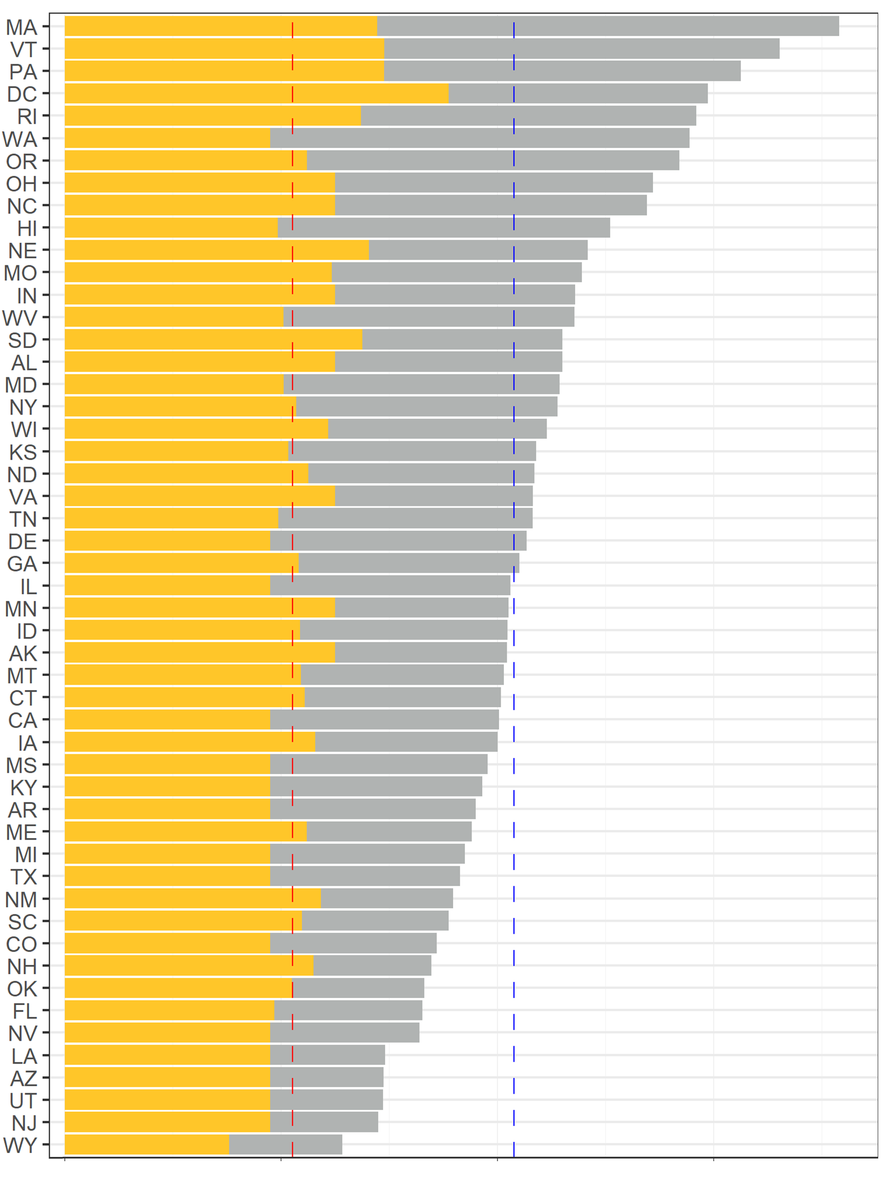
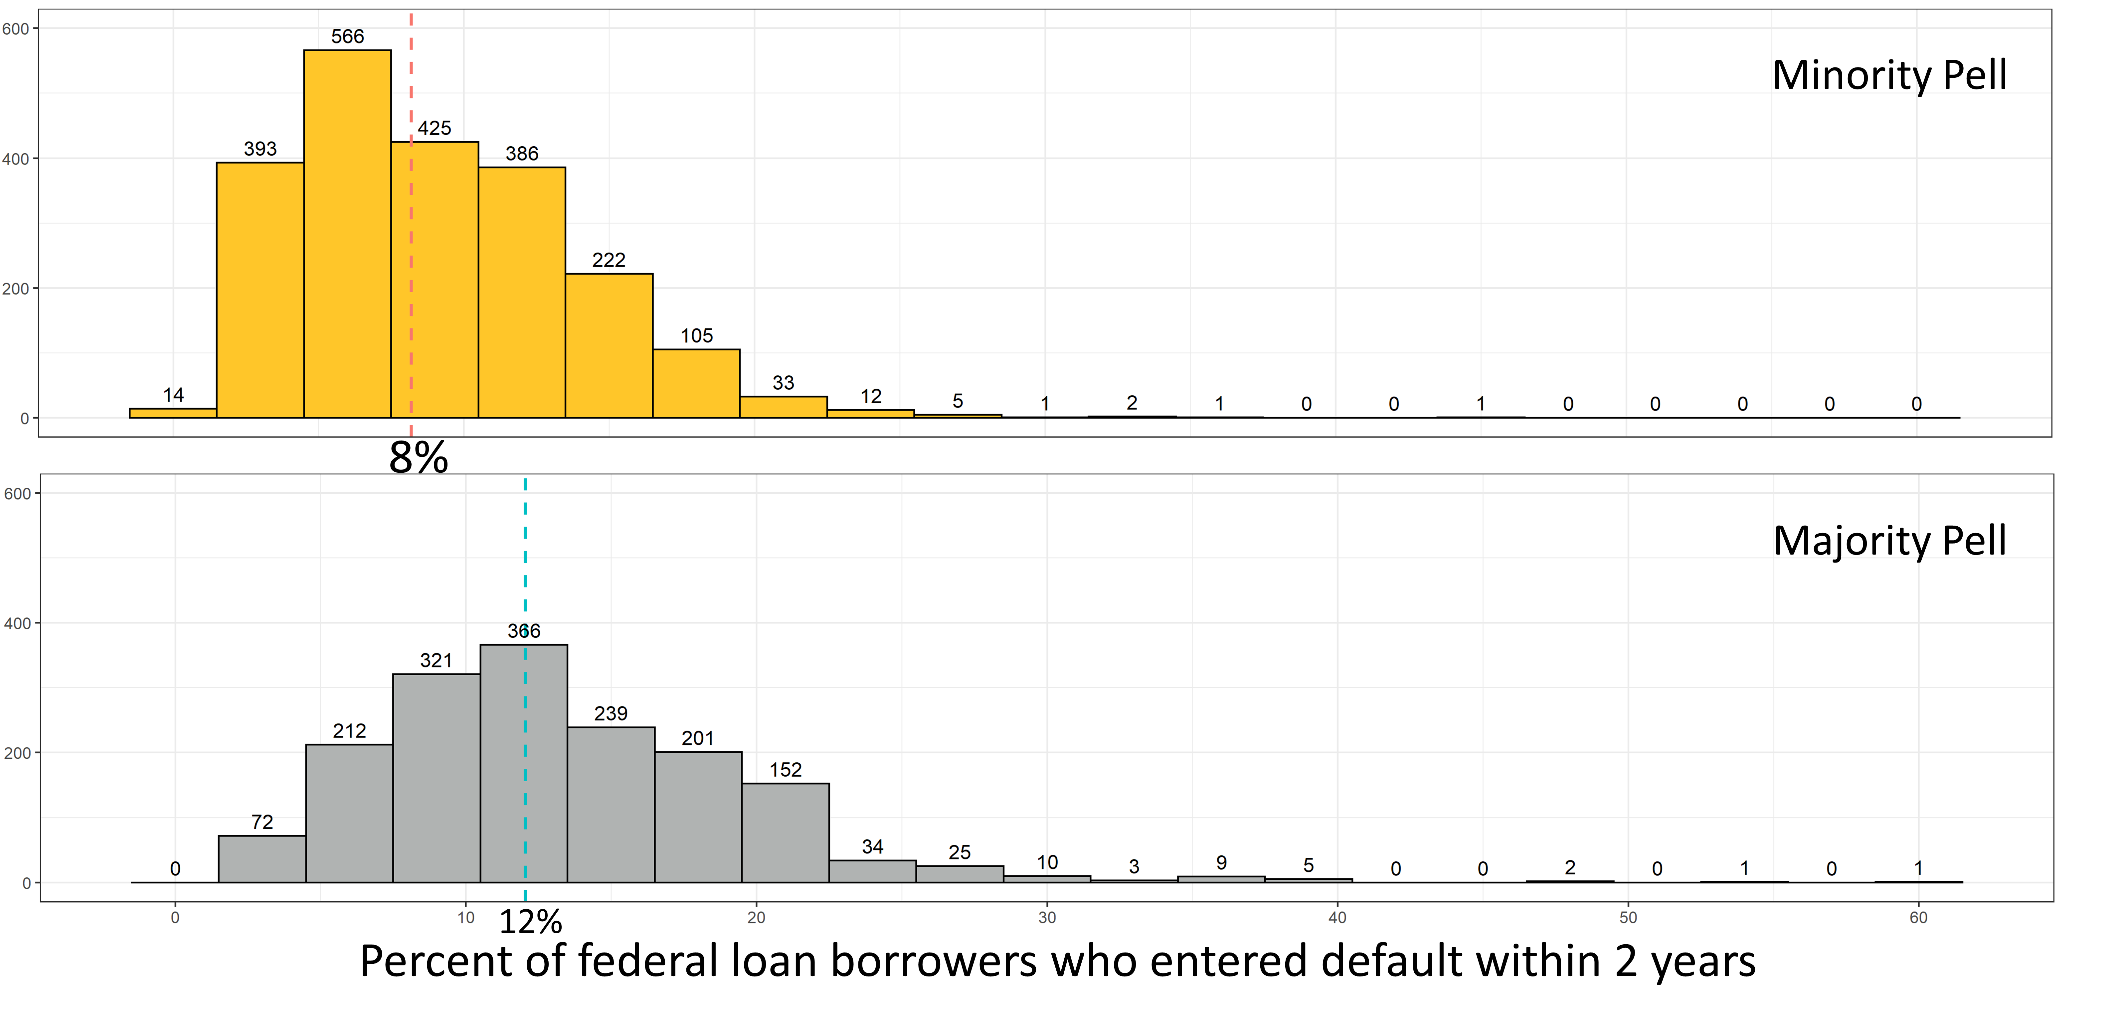
The CollegeScorecard dataset consist of 2,381 features, 3 id variables, and 6654 rows.
.7% of students
DOES THE PELL GRANT COME WITH A PRICE?
Nathaniel Jones
Faculty Advisor: Professor Susan Mathews Hardy and Professor J. Hathaway
INTRODUCTION
METHODS
CONCLUSIONS
The goal of this research is to use the CollegeScorecard dataset to determine which post-secondary schools and states are helping low-income students succeed. This success is measured by the institution’s student graduation rate, loan default rate two years after graduation, dropout rate, and the typical amount of debt acquired by an independent student or a dependent student with their parent as they exit the institution, either by graduating or dropping out. The proportion of students still trying to finish their degree 8 years after their first enrollment is 0.4%, I am one of those 0.4%. I had to learn the implications of the dependency status the hard way. I had to find a way to attend school, even when I was homeless, had medical issues, and could not afford food. I had to learn financial and life lessons that are usually taught by the family.
I propose that an educational institution provide mandatory training on the implications of dependent and independent status, as to whether the student will receive any of the parental loans that are taken out in their behalf. In addition, institutions, which have the majority of their student populations receiving a Pell grant, have lower graduation rates and higher dropout rates, resulting in higher loan default rates 2 years after the student leaves the institution. Educational institutions need to take their stewardship of Pell grant recipients seriously by providing coaching that will help them with academic success—skills that a high-income family generally provide for their children. By meeting the needs of Pell grant recipients, they will better meet the needs of all students at their institutions.
Coding Methods: I used tidyverse to pipe functions (e.g. mutate, filter, select, and lapply). I used packages that include stringr, pplyr, dplyr, magrittr, ggplot, ggpubr, ggh4x, geofacet, sf, sp, and tidycensus. My favorite package is magrittr because of the assignment pipe %<>%.
Data Wrangling: For the CollegeScorecard dataset, I created an anonymous function that checks each column for missing values, and then I dropped all columns with zero entries. Observations that were missing their institutions name, proportion of Pell recipients in their student population, their longitude and latitude, and their state were dropped. This left a total of 952 variables and 6186 observations. As I did my analyses, I created multi-layer filters to create the needed subsets.
Spatial Analysis: The census shapefiles and data from the packages tigris and tidycensus were used to create maps of the institutional locations by state. I joined together the polygons of the states that are provided in the shapefile with the latitude and longitude of each school from the CollegeScorecard data.
Nonparametric Binomial Distribution Test and Confidence Intervals: The binomial test was used to test verify the National Center for Education Statistics claim that the average net price at a 4-year institution is $18,500.
K-sample Permutation Tests: The K-sample Permutation Test was used to analyze whether graduation rate quartiles predicted the loan default rate.
Permutation Tests on the Median: For majority and minority Pell schools, I tested to see if there was a difference between the median dropout rate, graduation rate, and the 2-year loan default rate.
Permutation test on the slope: A permutation test on the slope of the model created to find associations between the independent and dependent student debt.
Geom_smooth: This function in ggplot was used to map the slope of independent student debt by dependent student debt over the state of the institution.
Student Dropout Rate: The dropout rate for majority Pell schools is 8% to 11% higher than minority Pell schools. Notably, stratifying by whether the school is a 2-year or a 4-year school displays that the dropout rate does not change for majority Pell schools ( 36% ), but the dropout rate at 4-year minority Pell schools reduces to 16% while the dropout rate increases to 42% at 2-year minority Pell schools. Visually, the distribution 2-year minority Pell schools more closely resembles majority schools rather than their 4-year counterparts.
Student Graduation Rate: The graduation rate of majority Pell schools are 1% to 4% lower than minority Pell schools. In addition, at 4-year majority Pell schools the graduation rate is 17% lower than 4-year minority Pell schools. 2-year majority Pell schools have a 28% higher graduation rate than minority Pell schools. Although the graduation rate at 2-year majority Pell schools is 56% at public 2-year majority Pells schools it is 26%.
Student Default Rate: For majority Pell schools, the median percent of students that is in default within 2 years of leaving their school is 3.5% to 4.2% higher than minority Pell schools. Furthermore, at schools with a graduation rate greater than 50% the proportion of loan borrowers who entered default within 2-years is 5%. In contrast, the loan default rate for schools with a graduation rate 50% or less is 11%.
Independent and Dependent Student Debt: A model was created for independent vs. dependent student debt. According to this model, for every unit increase in the median independent student debt the median dependent student debt will increase by $1.10.
Differences in the proportion of federal loan borrowers at majority vs minority Pell schools were tested. Confidence intervals on the difference in medians of the graduation rate, dropout rate, and loan default rate for majority and minority Pell schools were calculated.
The CollegeScorecard dataset includes measurements of the following parameters for 6,654 post-secondary institutions:
INSTNM: The name of the school.
STABBR: The state abbreviation.
LATITUDE & LONGITUDE: The latitude and longitude of the school.
PCTPELL: The percent of the student's population that receive a Pell grant.
ICLEVEL: The institutional class level (either 2-year or 4-year institution).
CONTROL: Whether the control of the institutions is public or private.
OMENRUP_ALL: The 8-year outcome status measured as the proportion of students that did not receive an award (either a training certificate, associate, bachelor, or graduate degree) within 8 years of entry and their status is unknown.
OMAWDP8_ALL: The 8-year outcome status measured as the proportion of students that did receive an award (either a training certificate, associate, bachelor, or graduate degree) within 8 years of entry.
BBRR2_FED_UG_DFLT: The Borrower-based Repayment Rate measured as the percentage of undergraduate federal student loan borrowers in default after 2 years. Loans need to be paid back as compared to a Pell grant, which does not. These loans are either government-subsidized (interest starts accruing after graduation) or unsubsidized (interest starts accruing at the time the loan is taken) loans.
IND_DEBT_MDN: The median amount of direct loans (government-subsidized and unsubsidized) an independent student receives while attending that university.
DEP_DEBT_MDN: The median amount of direct loans (government-subsidized and unsubsidized) a dependent student receives while attending that university.
PLUS_DEBT_INST_MD: The median Parent Loan for Undergraduate Students (PLUS) loan debt disbursed at the school for all students.
Combining the latitude and longitude in the CollegeScorecard dataset with the United States Census shapefiles, I created a United States map for my analysis of the relationship between the typical amount of debt an independent student receives and the typical amount of debt a dependent student with their parents' debt receives while attending school.
RESULTS
Dependent and Independent Student Debt by State
Independent and Dependent Student Debt by State
Student Dropout Rate
Graduation Rate stratified for 2-year and 4-year Institutions
Typical Dependent Student Debt with Parent Debt
State
Typical Independent Student Debt
Breakdown of Pell, Years, and Control
Default Rate Stratified by Graduation Rate
Median Loan Default Rate
Independent
Dependent
LinkedIn
GitHub CODE
Github
QR
1 block = 20 schools
Notes:
INTRODUCTION
End with why I am passionate and .7% goes here.
What we need:
-intro, methods, and conclusions finished
-Notebook breakers for k-sample perm tests, perm tests on the median, perm tests on the slope.

Slide 4
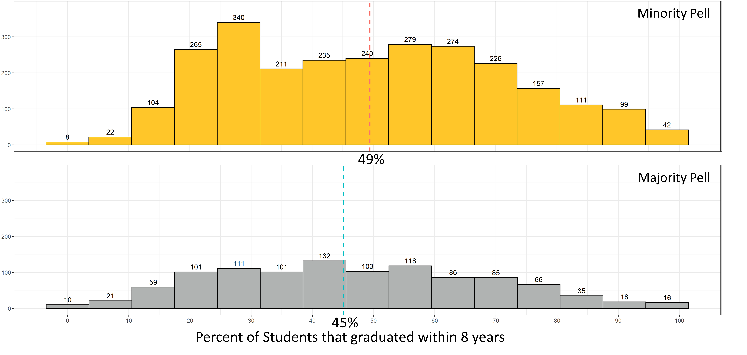
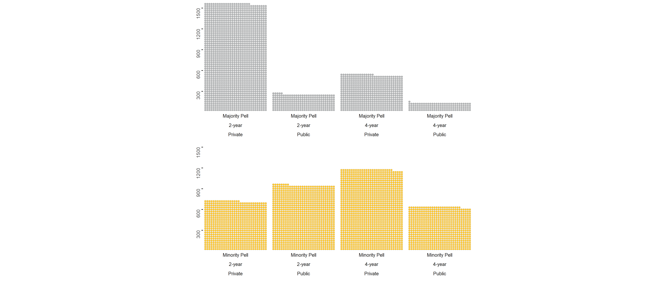
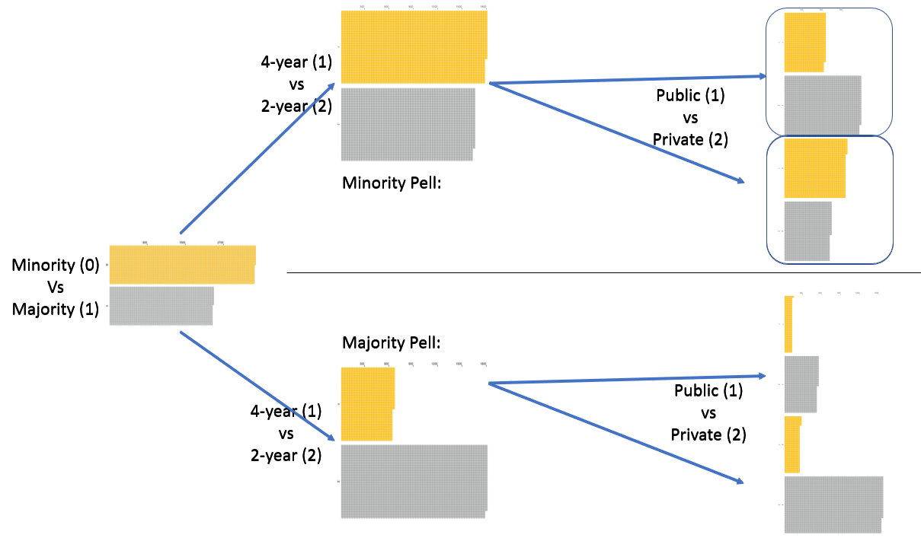
Put in notebook
Bimodal Graduation Rate due to 2-year and 4-year Institutions
DOES THE PELL GRANT COME WITH A PRICE?
Nathaniel Jones
Faculty Advisor: Professor Susan Mathews Hardy and Professor J. Hathaway
Graduation Rate stratified for 2-year and 4-year Institutions
INTRODUCTION
RESULTS
The goal of this research is to determine ways to save money, improve efficiency, and make sure the proper safety guidelines are being followed for a cold storage warehouse. This data set is comprised of outbound orders from this warehouse from May 13, 2019 through June 13, 2019. The warehouse has a total of fifty-two customers that store and move their product on a regular basis within the facility.
There were originally fifty-six variables in this data set, but I will list the ones that I used for these analyses below:
Customer Name: The name of the customer paying for space in the warehouse.
Aisle: The label for the aisle from which the order was picked.
Full_Cases: The total number of cases pulled if this order was a full pick.
Part_Cases: The total number of cases pulled if this order was a partial pick.
Part_Line: Tells directly if the order was a partial pick or not where ‘1' = yes and ‘0' = no.
Level: Shelf (bay) level in the warehouse. Ranges from Low (A) to High (E).
Hi: The height of the pallet in case height.
Unit Weight: The weight of a single case on a pallet in pounds.
BHi_Qty: The number of cases on a pallet.
There are 14,659 outbound orders in this data set. I conducted multiple analyses to determine improvements for this warehouse.
Independent and Dependent Student Debt by State
Student Dropout Rate
The CollegeScorecard dataset consist of 2,381 features, 3 id variables, and 6654 rows.
.7% of students
Graduation Rate stratified for 2-year and 4-year Institutions
Typical Dependent Student Debt with Parent Debt
State
Typical Independent Student Debt
METHODS
Coding Methods: I used tidyverse to pipe functions like mutate, filter, select, lapply, and others along side packages like stringr, pplyr, dplyr, magrittr, ggplot, ggpubr, ggh4x, geofacet, sf, sp, and tidycensus. My favorite package is magrittr because of the assignment pipe %<>%.
Data Wrangling: For the CollegeScorecard dataset, I created an anonymous function that checks each column for missing values and then dropped all columns with zero entries. Observations that were missing their institutions name, proportion of Pell recipients in their student population, their longitude and latitude, and their state were dropped. This left a total of 952 variables and 6186 observations.
Spatial Analysis: The census shapefiles and data from the packages tigris and tidycensus were used to create maps of the schools.
Nonparametric Binomial Test: description
Permutation chi-square test: Were used to….
two-sample permutation tests on the median
k-sample permutation tests on the median
Analysis of Variances
Dependent and Independent Student Debt by State
Breakdown of Pell, Years, and Control
Median Loan Default Rate
CONCLUSIONS
Customer Versus Partial/Full Pick: In Table 1, we are 95% confident that the variable Customer Name predicts whether the pallet will be partial picked or not. In Figure 1, when what we observed is higher than what we expected for no relationship between the Customer and Partial Pick, the colors are blue. The bigger the blue circle the more the observed and expected counts differed. Correspondingly when what we observed is lower than what we expected, it is orange. KI is much higher in partial picks and much lower in full picks than we expected. Both AFI and WHB had higher full picks and lower partial picks than expected.
KI Travel Distances: In Figure 2, each aisle adds distance to the forklift driver’s trek to find a pallet for an order. The aisle frequented the most for KI is aisle I. The aisle frequented the least for KI is aisle E. In Table 2, I measured how many feet these forklift drivers were travelling for an average KI order. I then converted these feet into miles for Table 2. From there, I measured the distance that consolidating KI 's product into one aisle would save. I calculated a reduction in travel of 897.2 miles a year. This translates into cost savings of $5,382 per year or 14.3% of the salary of a full-time employee. In addition there is cost savings in forklift maintenance and through avoiding penalties in trucks not loaded in 3 hour allotted time period.
KI Partial Versus Full Picking: In Figure 3, we see that KI is Partial Picking 73.9% of its orders, which is important because their contract price is based on them only having 25% Partial Picked orders. The Industrial Engineers give the forklift drivers 7 minutes to partial pick a pallet, and 3 minutes to full pick a pallet. Per the contract, they should be spending about $1,416 a month on labor for KI, but they're spending $2,107 a month. This means, that annually the warehouse is at an $8,300 deficit just in labor costs for this customer. In Figure 4, the orange bar represents the number of KI orders that are full pallet picks. The blue bars to the left are the number of cases picked in a partially picked order. The customer gets charged per partial order based on the weight of the case and the number of cases in that order. KI is not only being charged too little for it's 73.1% partially picked orders instead of 25% for those partial orders, but they are also not being charged for the additional weight that those extra partially picked orders cost the warehouse to move. The specific amount is known by the Supply Chain Solutions group, but I have not heard back from them yet.
1 block = 20 schools
Default Rate Stratified by Graduation Rate
LinkedIn
GitHub CODE
Github
QR
Notes:
INTRODUCTION
End with why I am passionate and .7% goes here.
What we need:
-intro, methods, and conclusions finished

Slide 5
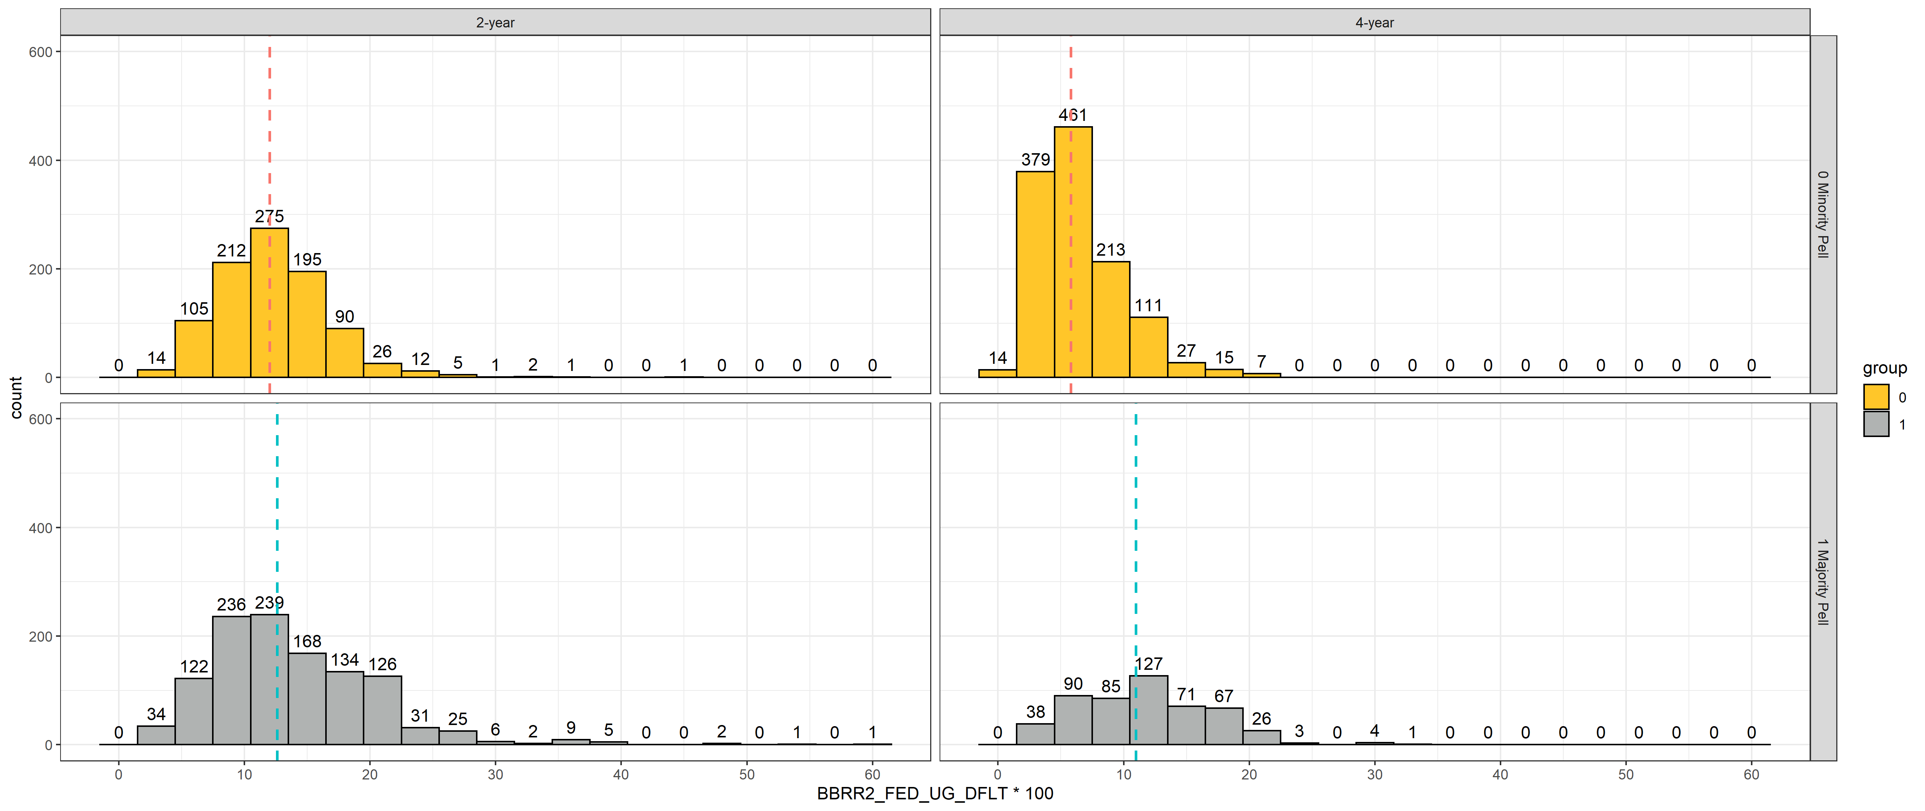
2-year
Minority Pell
4-year
12%
5.8%
2-year
Majority Pell
4-year
12.6%
11%
Percent of federal loan borrowers who entered default within 2 years
Notes:
PELLCAT2 ICLEVEL2 grp.median
1 0 Minority Pell 2-year 12.0
2 0 Minority Pell 4-year 05.8
3 1 Majority Pell 2-year 12.6
4 1 Majority Pell 4-year 11.0

Slide 6
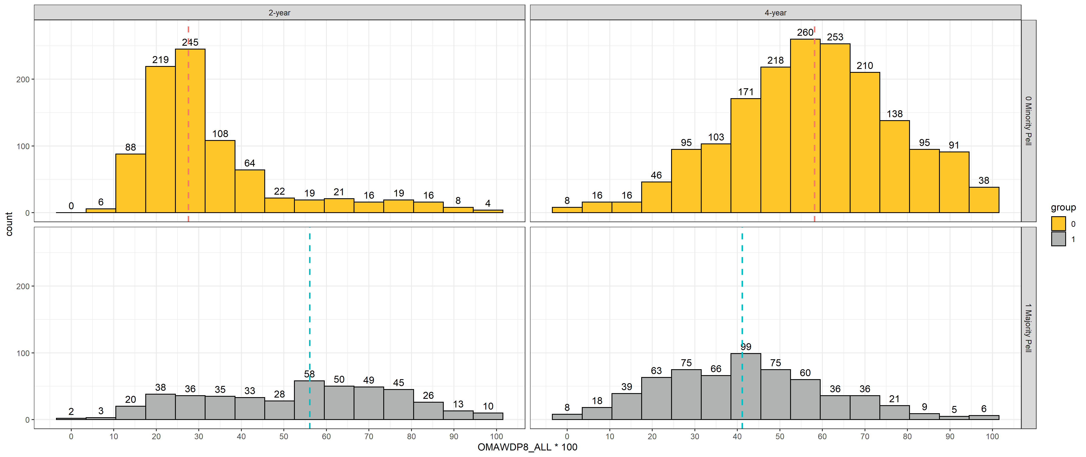
2-year
Minority Pell
4-year
28%
58%
2-year
Majority Pell
4-year
Public 26%
Private 62%
56%
41%
Percent of Students that graduated within 8 years

Slide 7
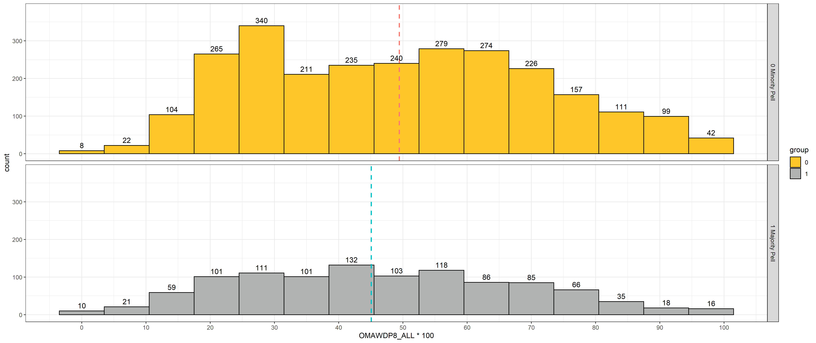
Minority Pell
49%
Majority Pell
45%
Percent of Students that graduated within 8 years

Slide 8
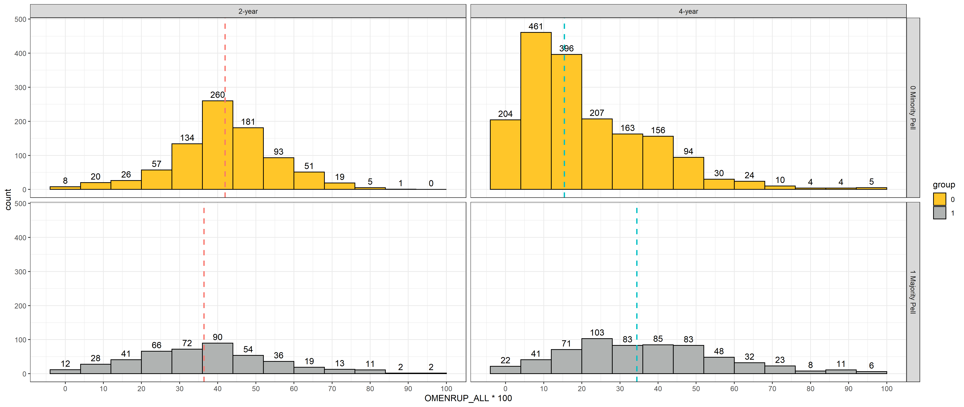
2-year
4-year
Minority Pell
42%
16%
Majority Pell
36%
Dropout rate
36%

Slide 9
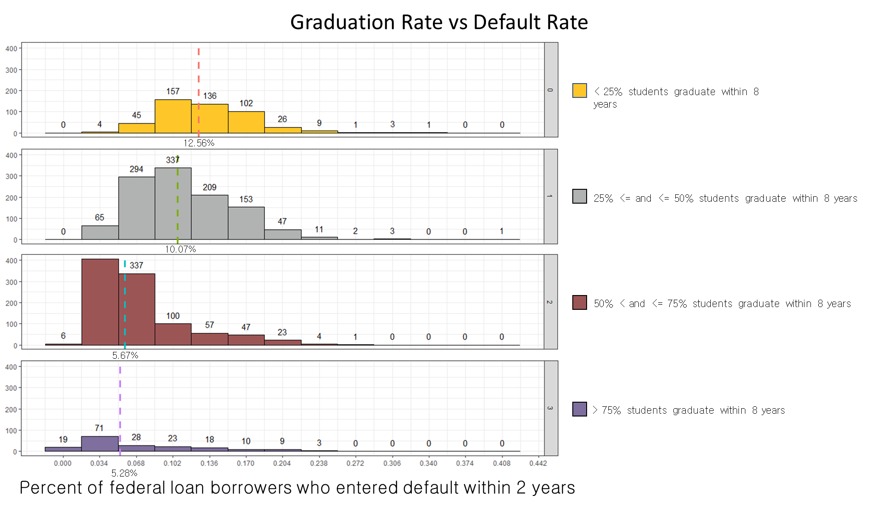

Slide 10
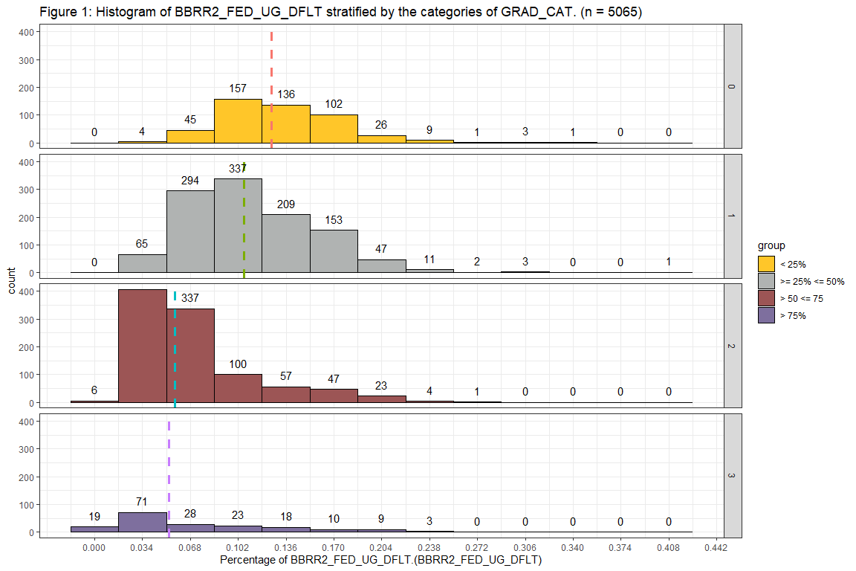
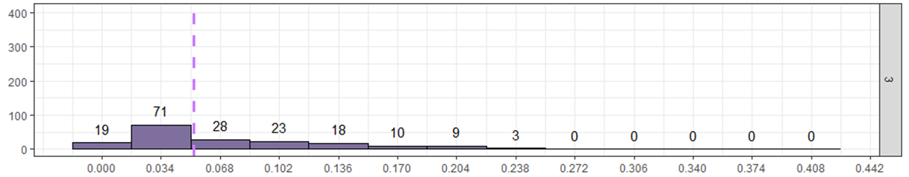
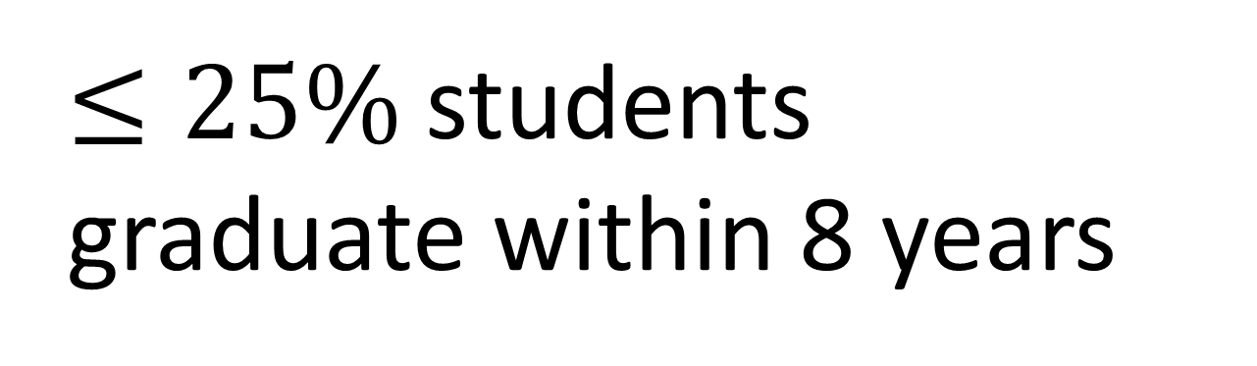
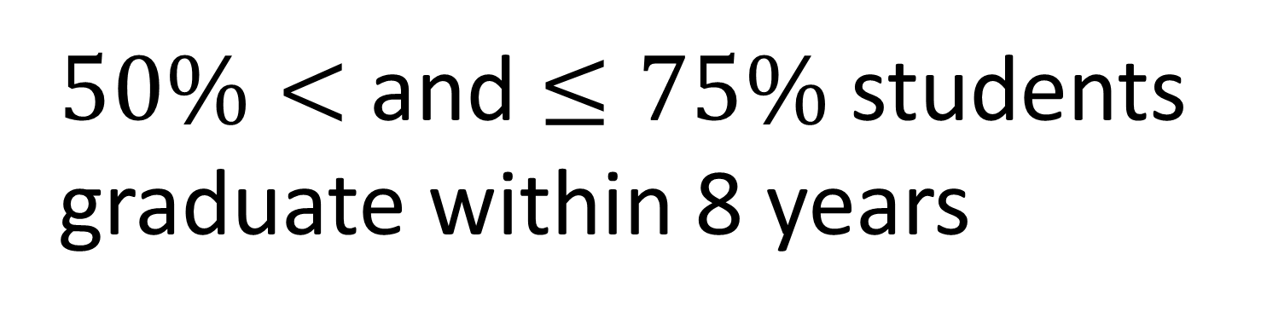
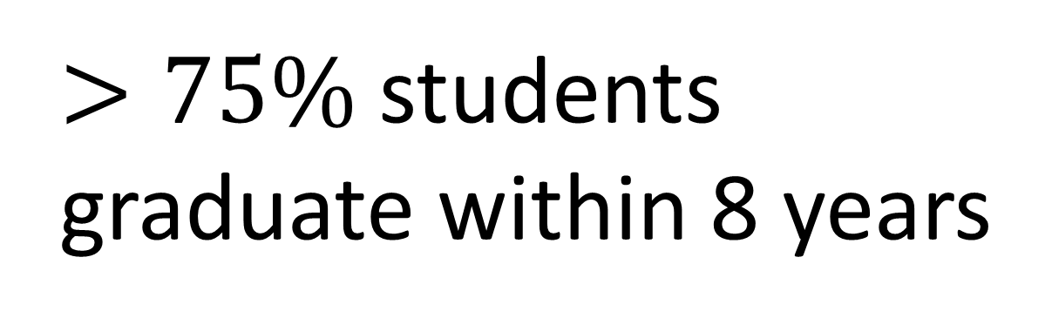
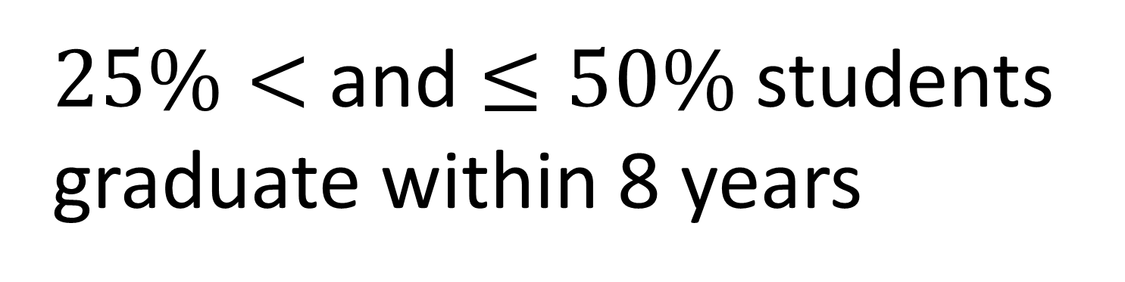
$≤25\%$students
graduate within 8 years
12.56%
$25\%<$and $≤50\%$students
graduate within 8 years
count
400
10.07%
$50\%<$and $≤75\%$students graduate within 8 years
5.67%
$>75\%$ students graduate within 8 years
5.28%
Percent of federal loan borrowers who entered default within 2 years
Notes:
USER FRIENDLY Hypothesis
Can remove ks logo
The question we are on turn colors.

Slide 11
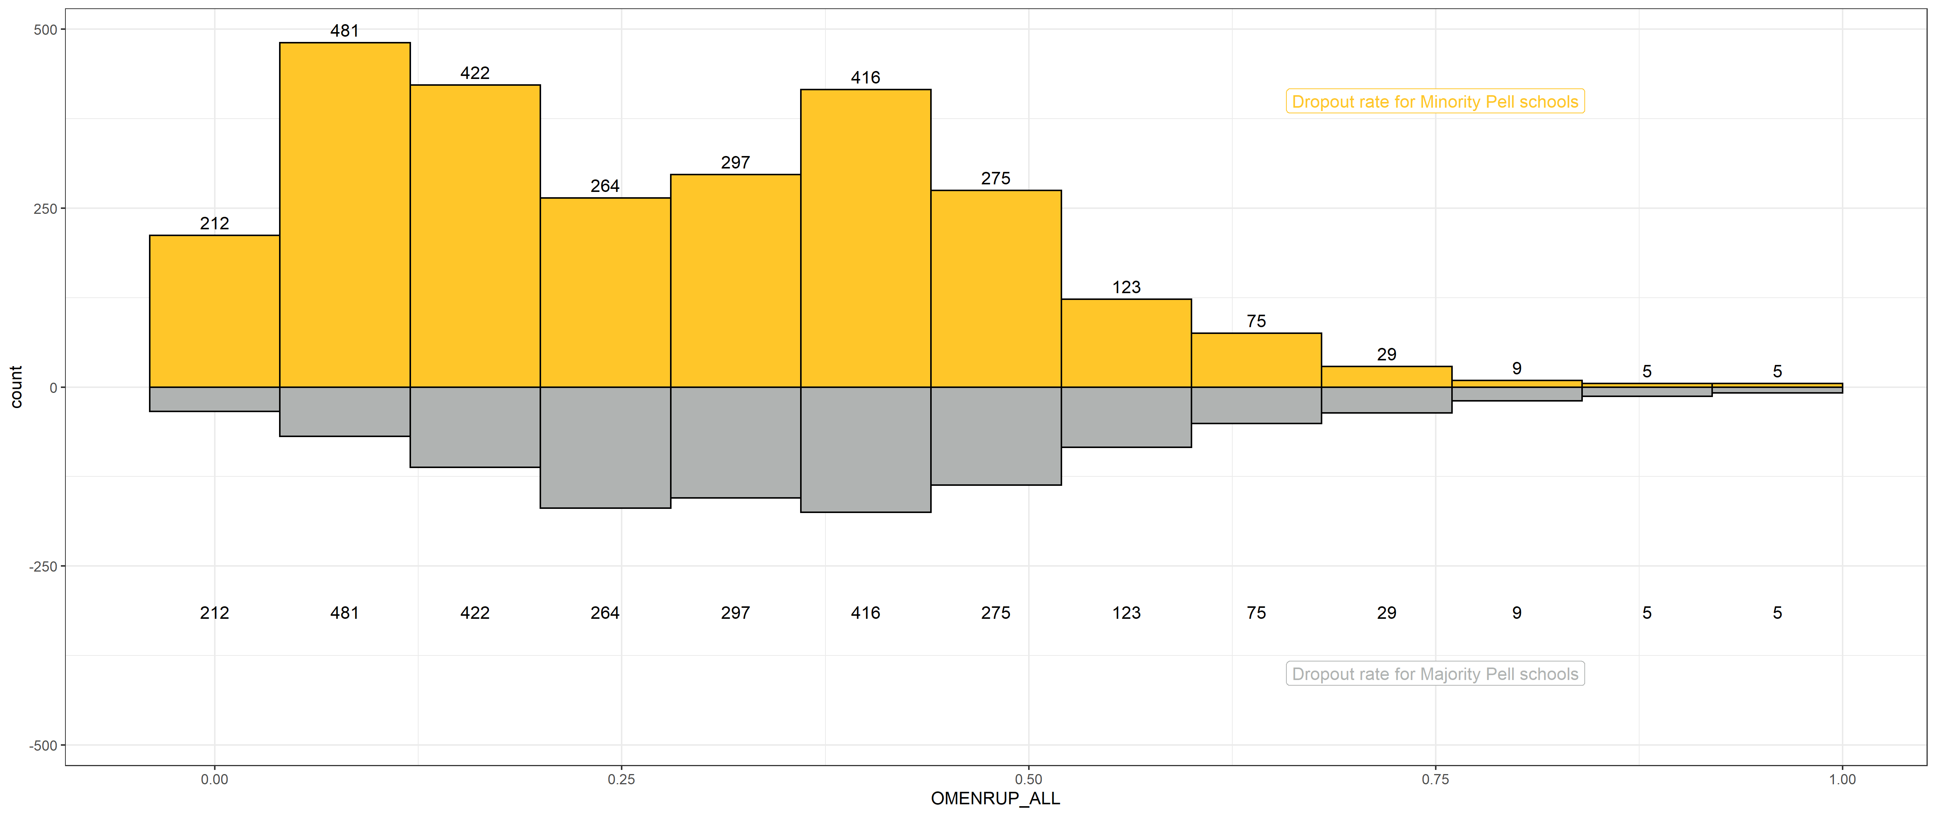
Minority Pell
Majority Pell

Slide 12
Public
2-year
Minority Pell
Private
4-year
Majority Pell

Slide 13
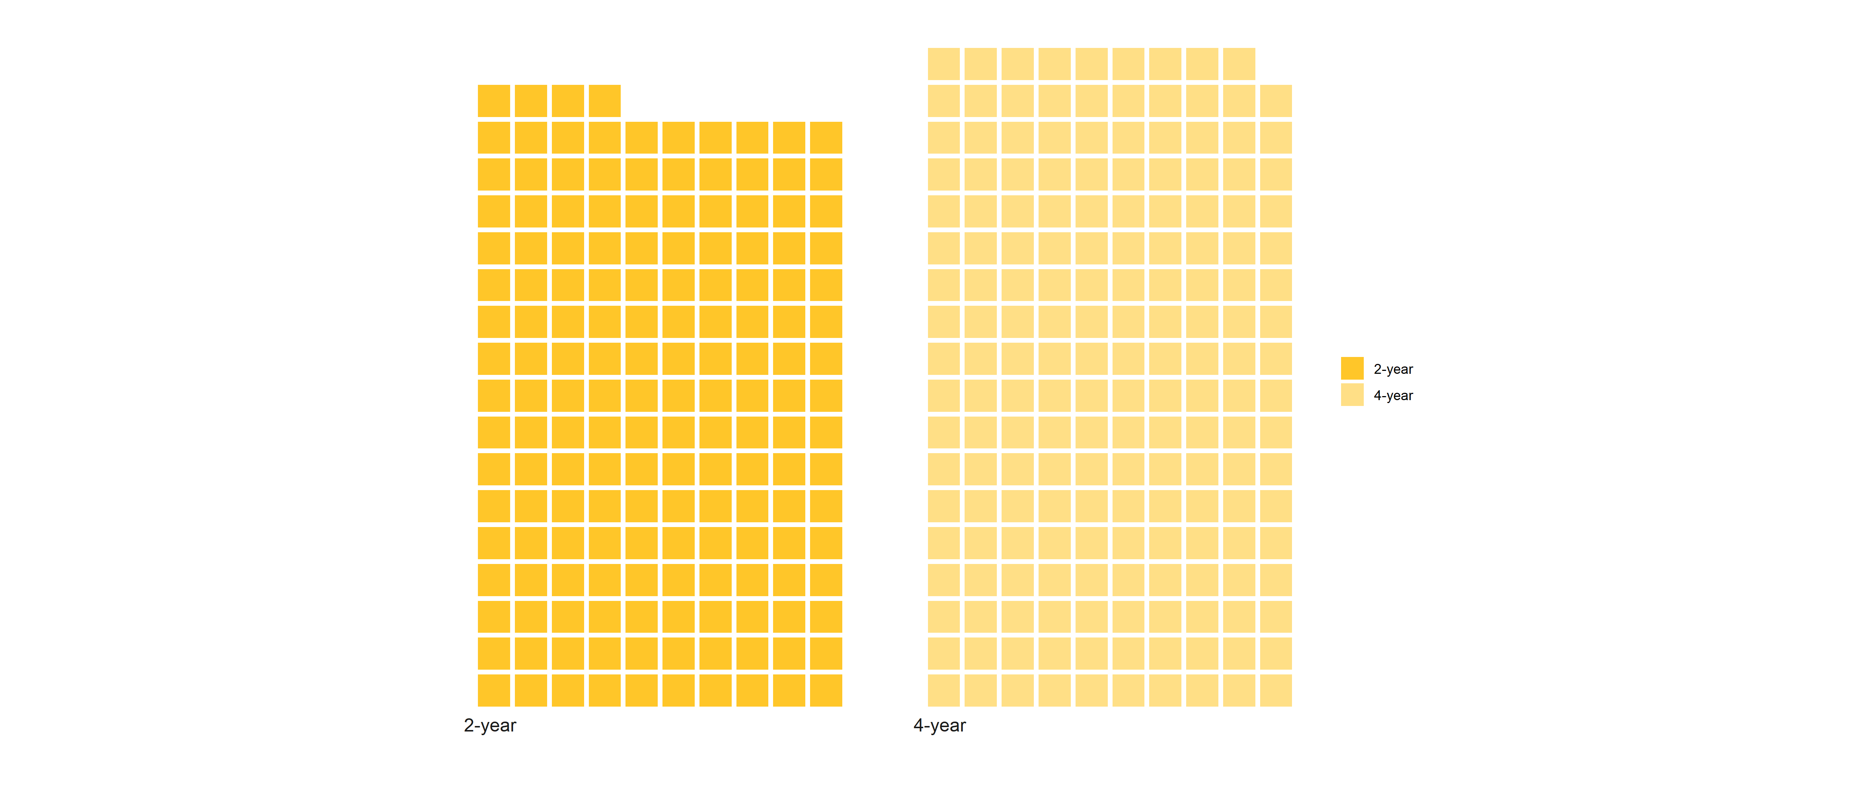
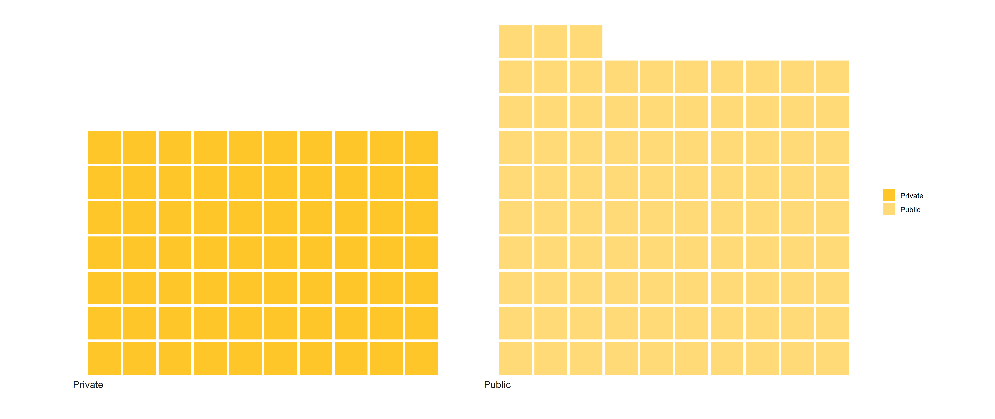
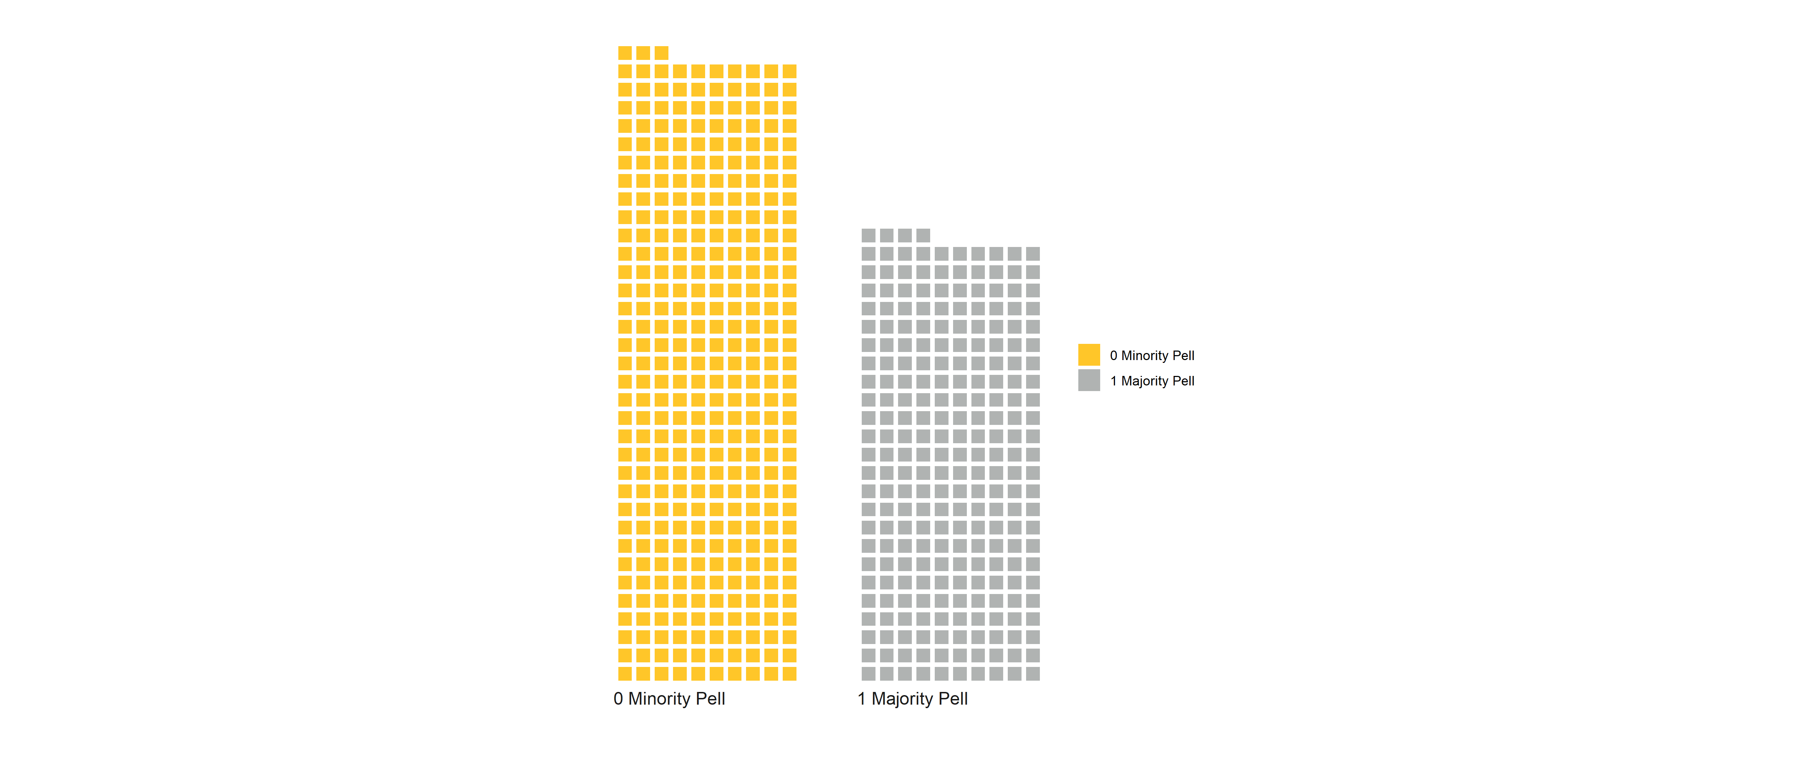
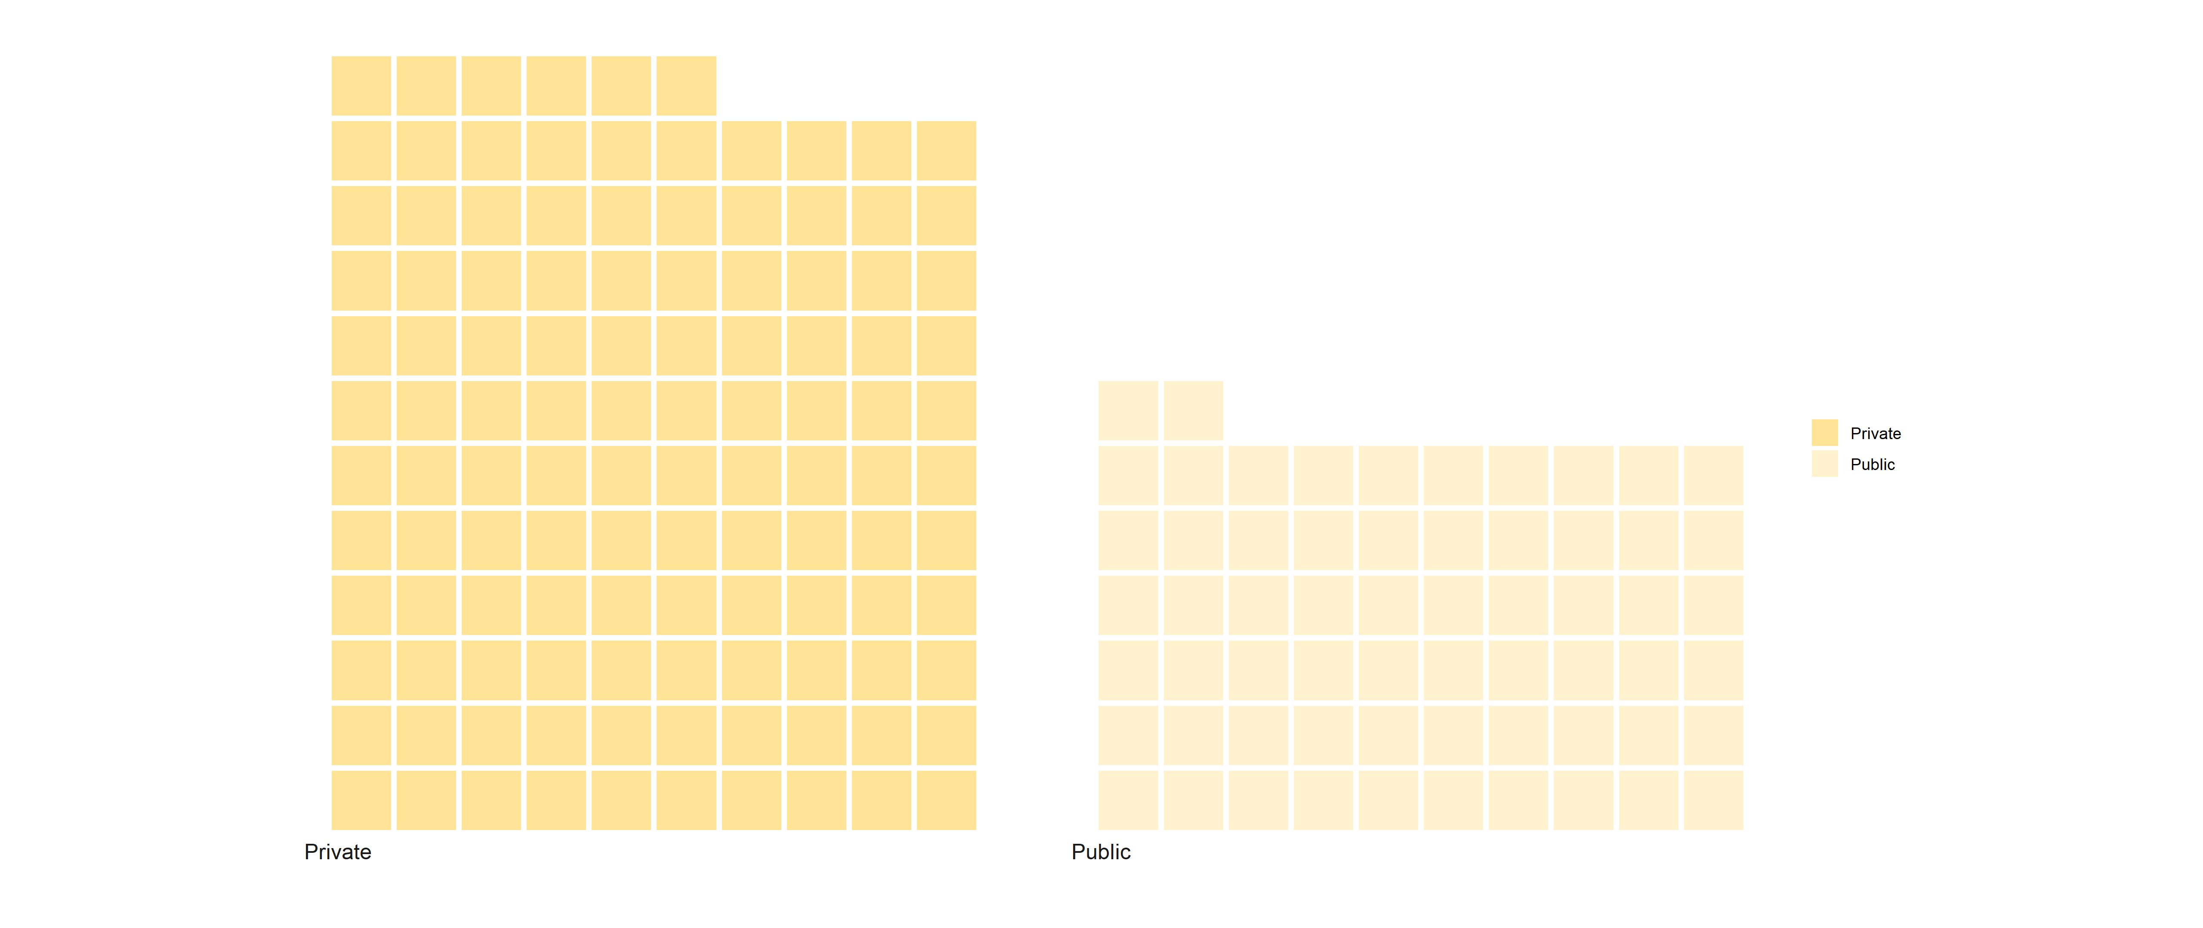
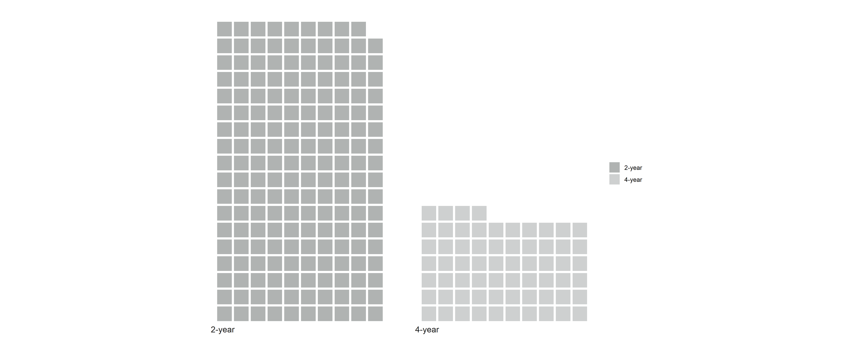
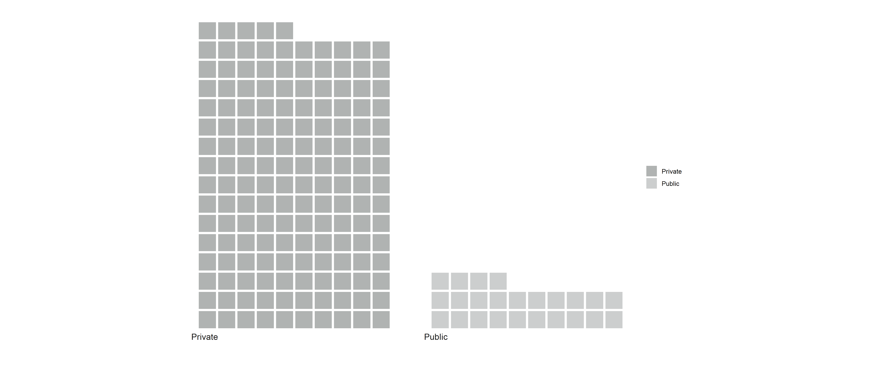
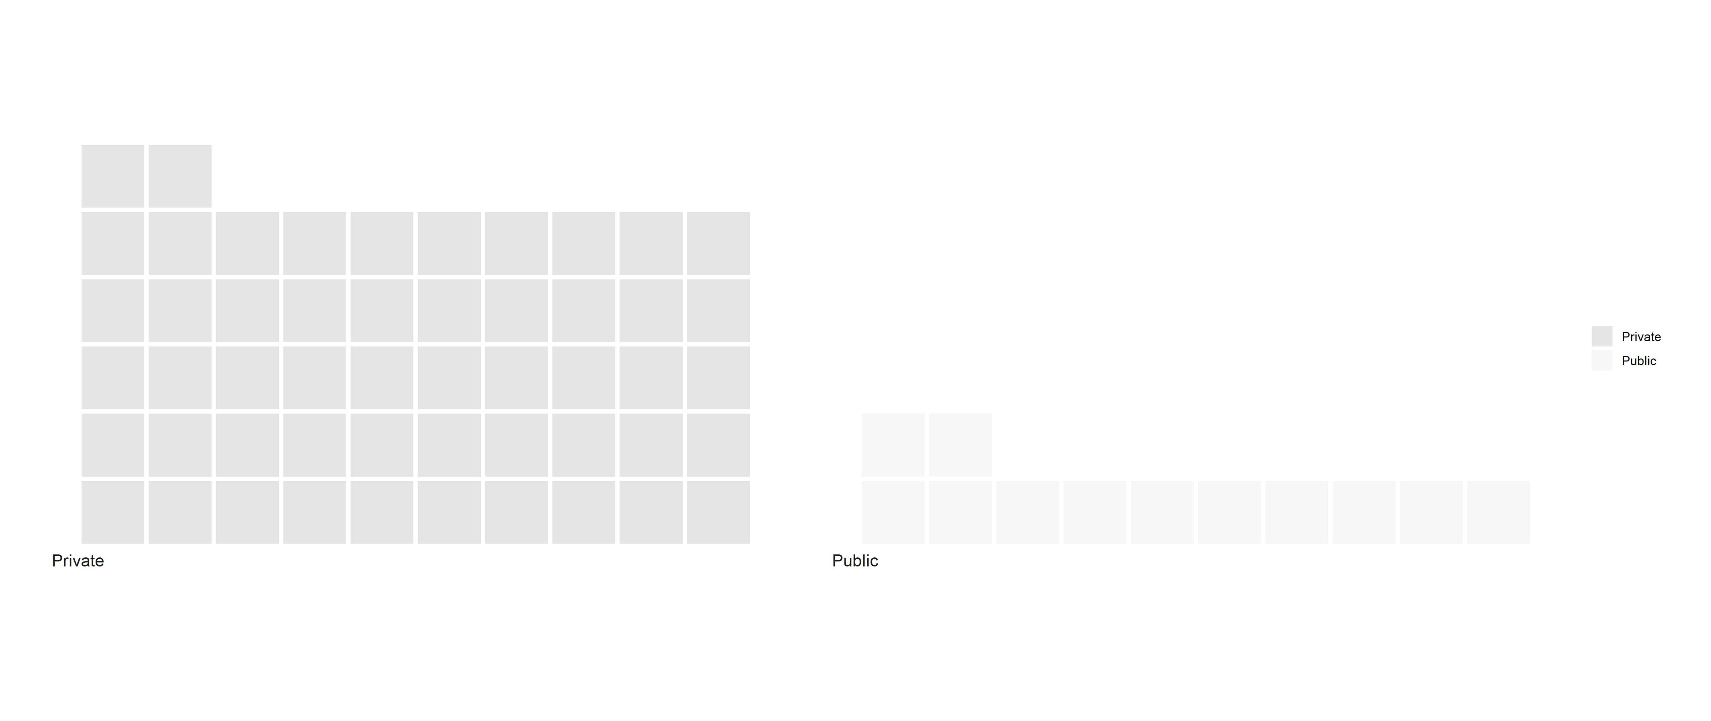
2-year
4-year
Minority Pell
Majority Pell
Public
2-year
4-year
Minority Pell
2-year
4-year
Majority Pell
Private

Slide 14
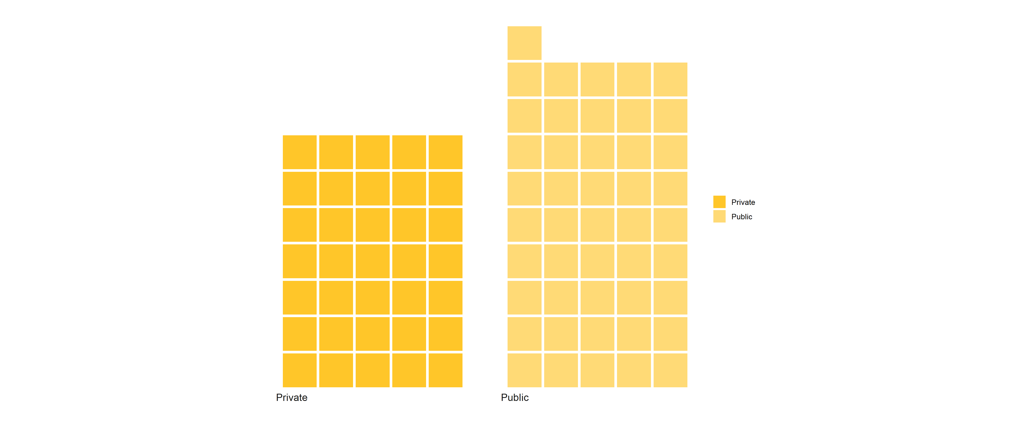
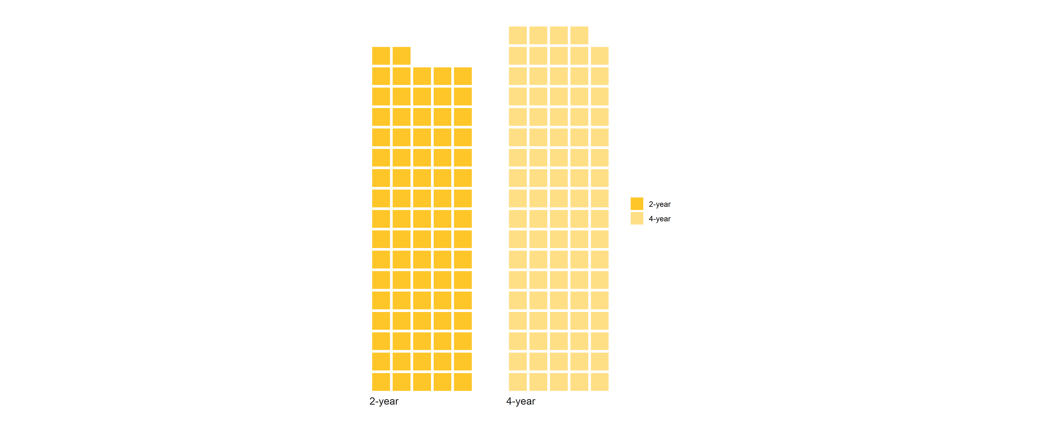
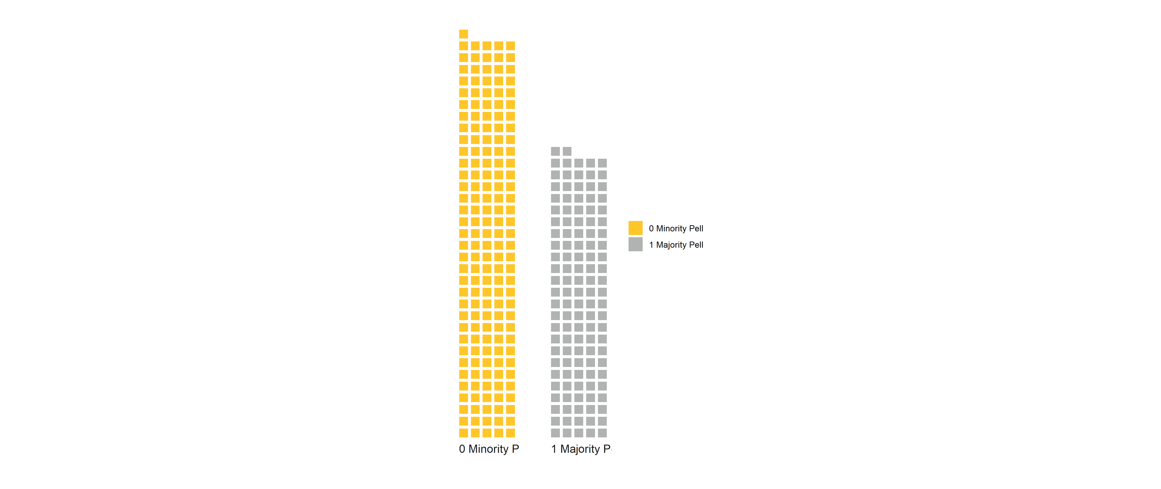
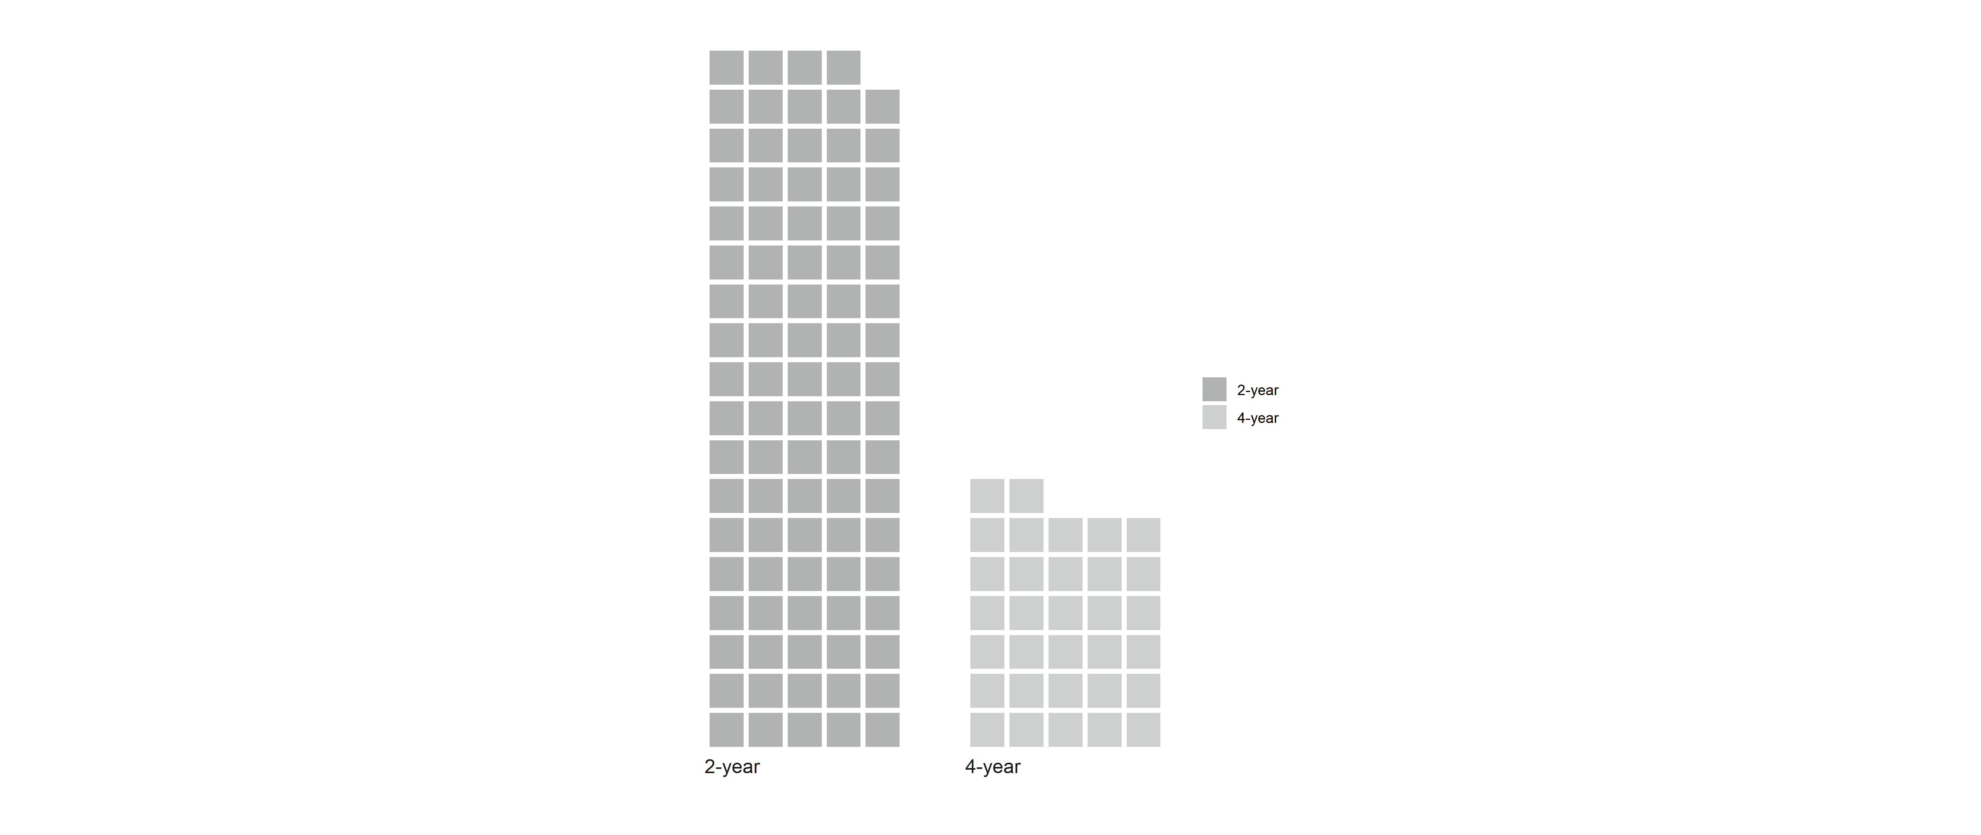
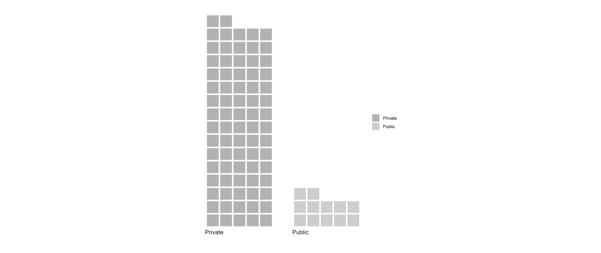
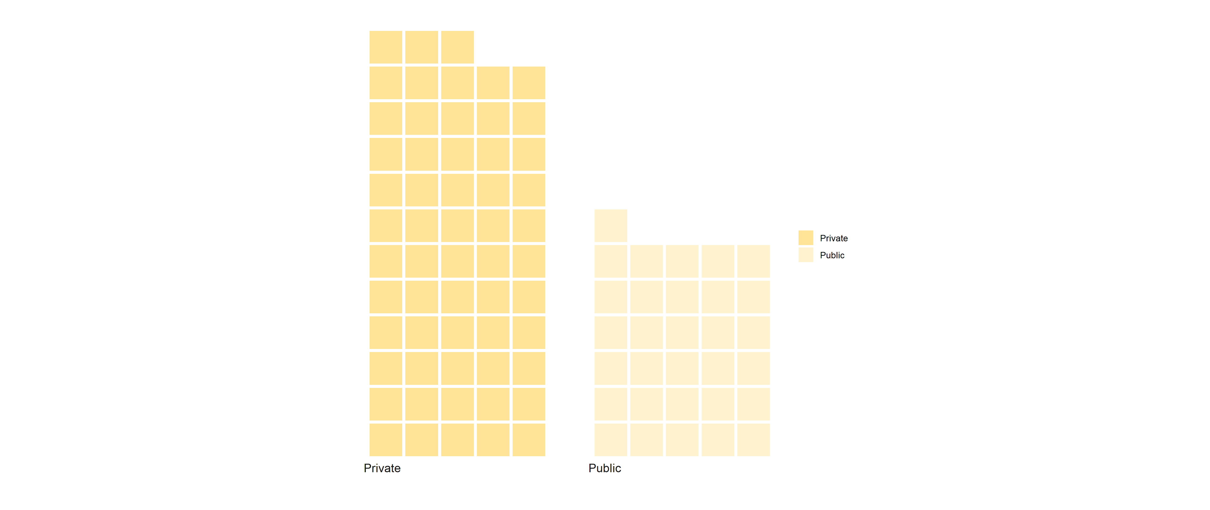
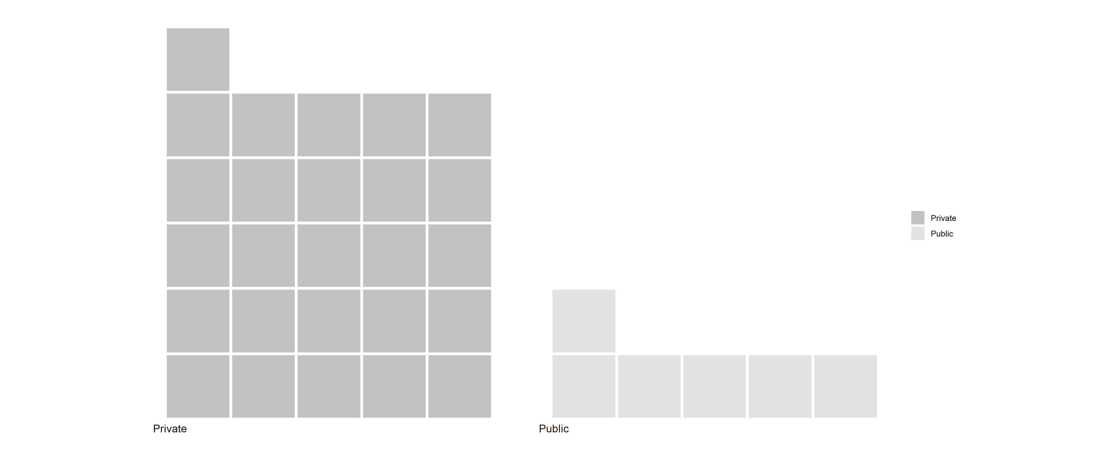

Slide 15
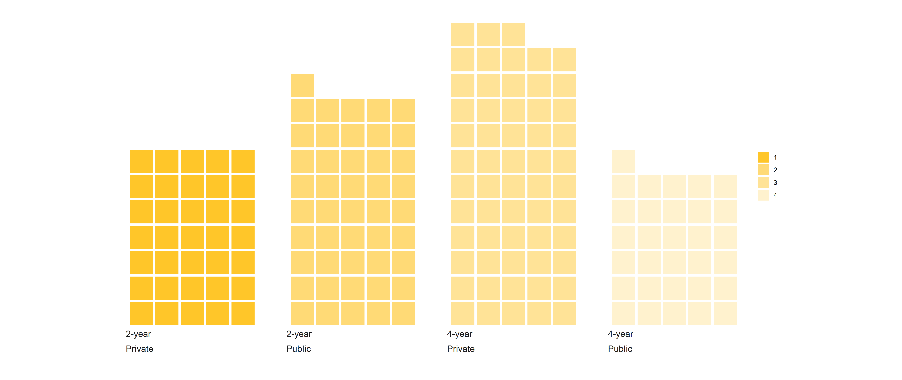
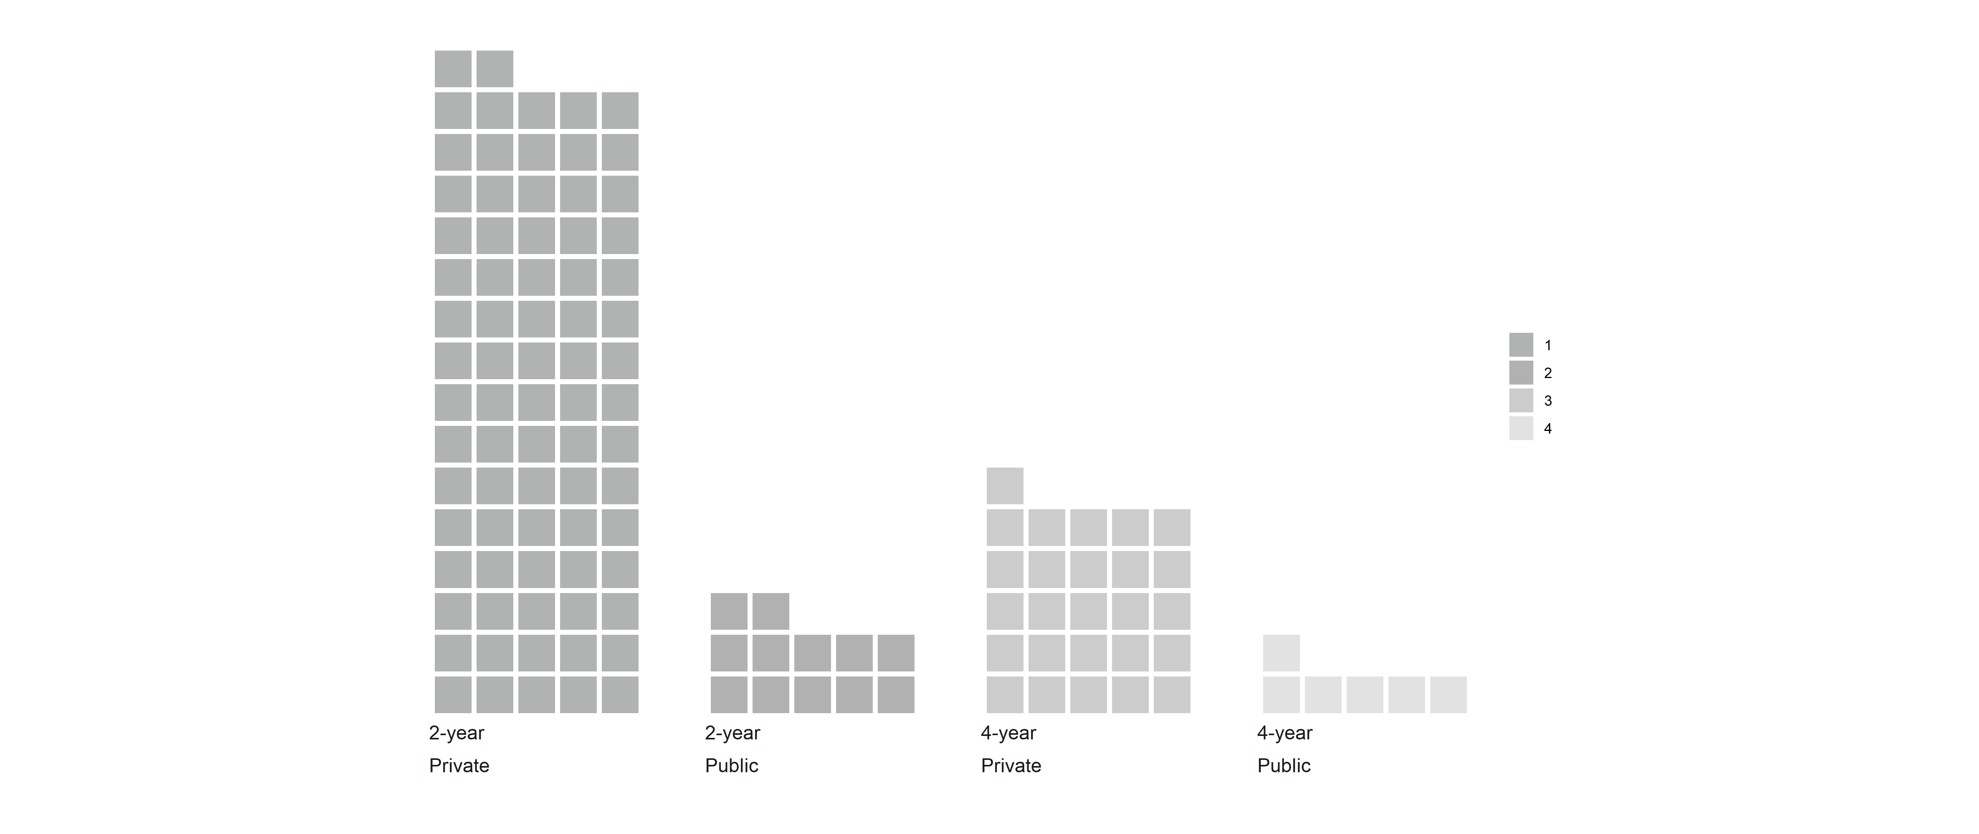
Private 2-year
2-year
Public 2-year
4-year
Private 4-year
Minority Pell
Public 4-year
Majority Pell
Private 2-year
2-year
Public 2-year
4-year
Private 4-year
Public 4-year

Slide 18
Put in notebook
Bimodal Graduation Rate due to 2-year and 4-year Institutions
Graduation Rate stratified for 2-year and 4-year Institutions

